Slide 1
MSP TOOLBOX – THE MEDITERRANEAN MSP WORKSPACE
By: Marina Marković (PAP/RAC)
Meeting of PAP/RAC Focal Points, 24-25 May 2021

Slide 2
MSP Toolbox?
The challenge is to create a space in which planners can access not only information and tools, but also benefit from knowledge, insight and wisdom a combination of library, technical support and news site relevant to specificities of the Mediterranean.
The term ‘toolbox’ does not adequately capture the nature of such a space.

Slide 3
MSP Toolbox?

Slide 4
Mediterranean MSP Workspace
fit within, and be complimentary to, the existing PAP/RAC ICZM Platform
be easily updateable
be interactive
respect the diversity of approaches and legal frameworks for MSP around the region
help practitioners align their plans and processes with the ICZM Protocol of the Barcelona Convention.
help practitioners to assess their own progress and provide a check list for activities throughout the planning process as set out in the agreed Conceptual Framework for Marine Spatial Planning in the Mediterranean.

Slide 5
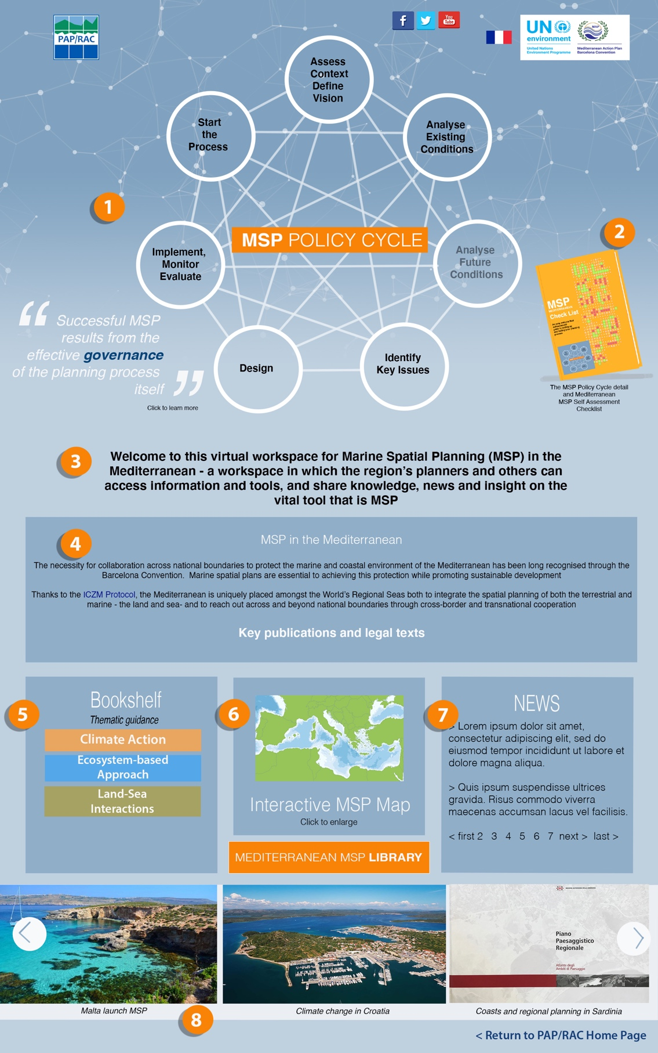
Mediterranean MSP Workspace
Governance
Governance
Climate action
Ecosystem approach
Land-sea interractions
MSP experiences

Slide 6
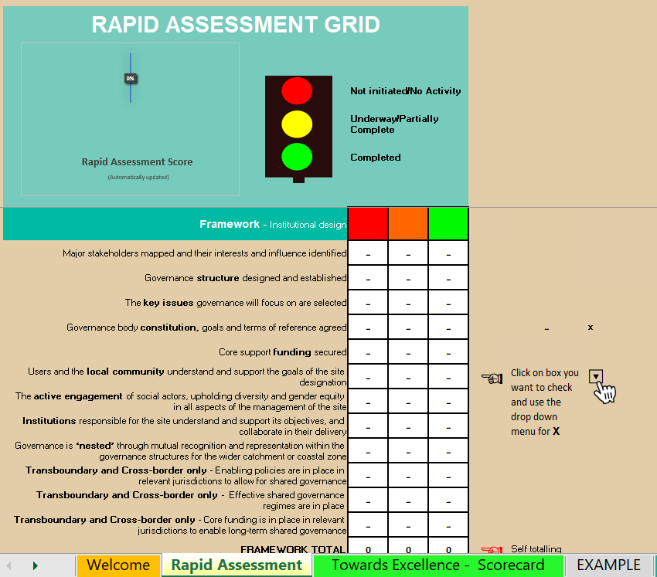
Mediterranean MSP Workspace
Self-assessment tools

Slide 7
Mediterranean MSP Workspace

Slide 8
Thank you!

