Slide 1
ICZM Policy in Cyprus
Irene CONSTANTINOU / Department of Environment / Ayia Napa, 25 September 2019
Photo credit to be given
as shown alongside
(in black or in white)

Slide 2
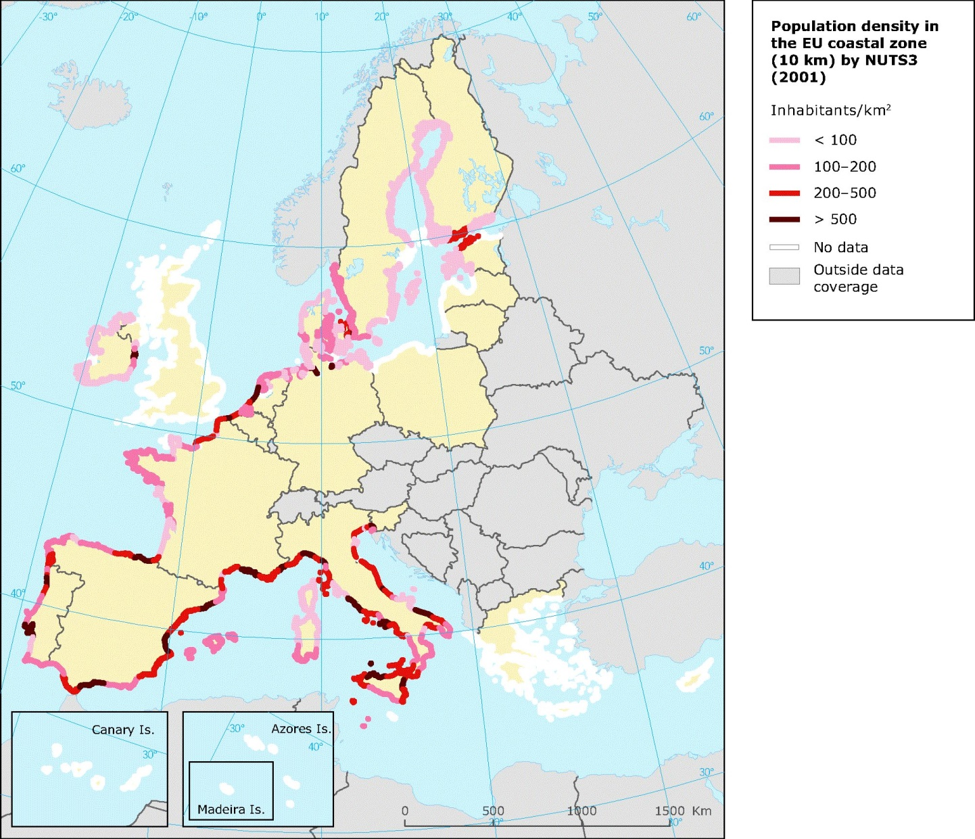
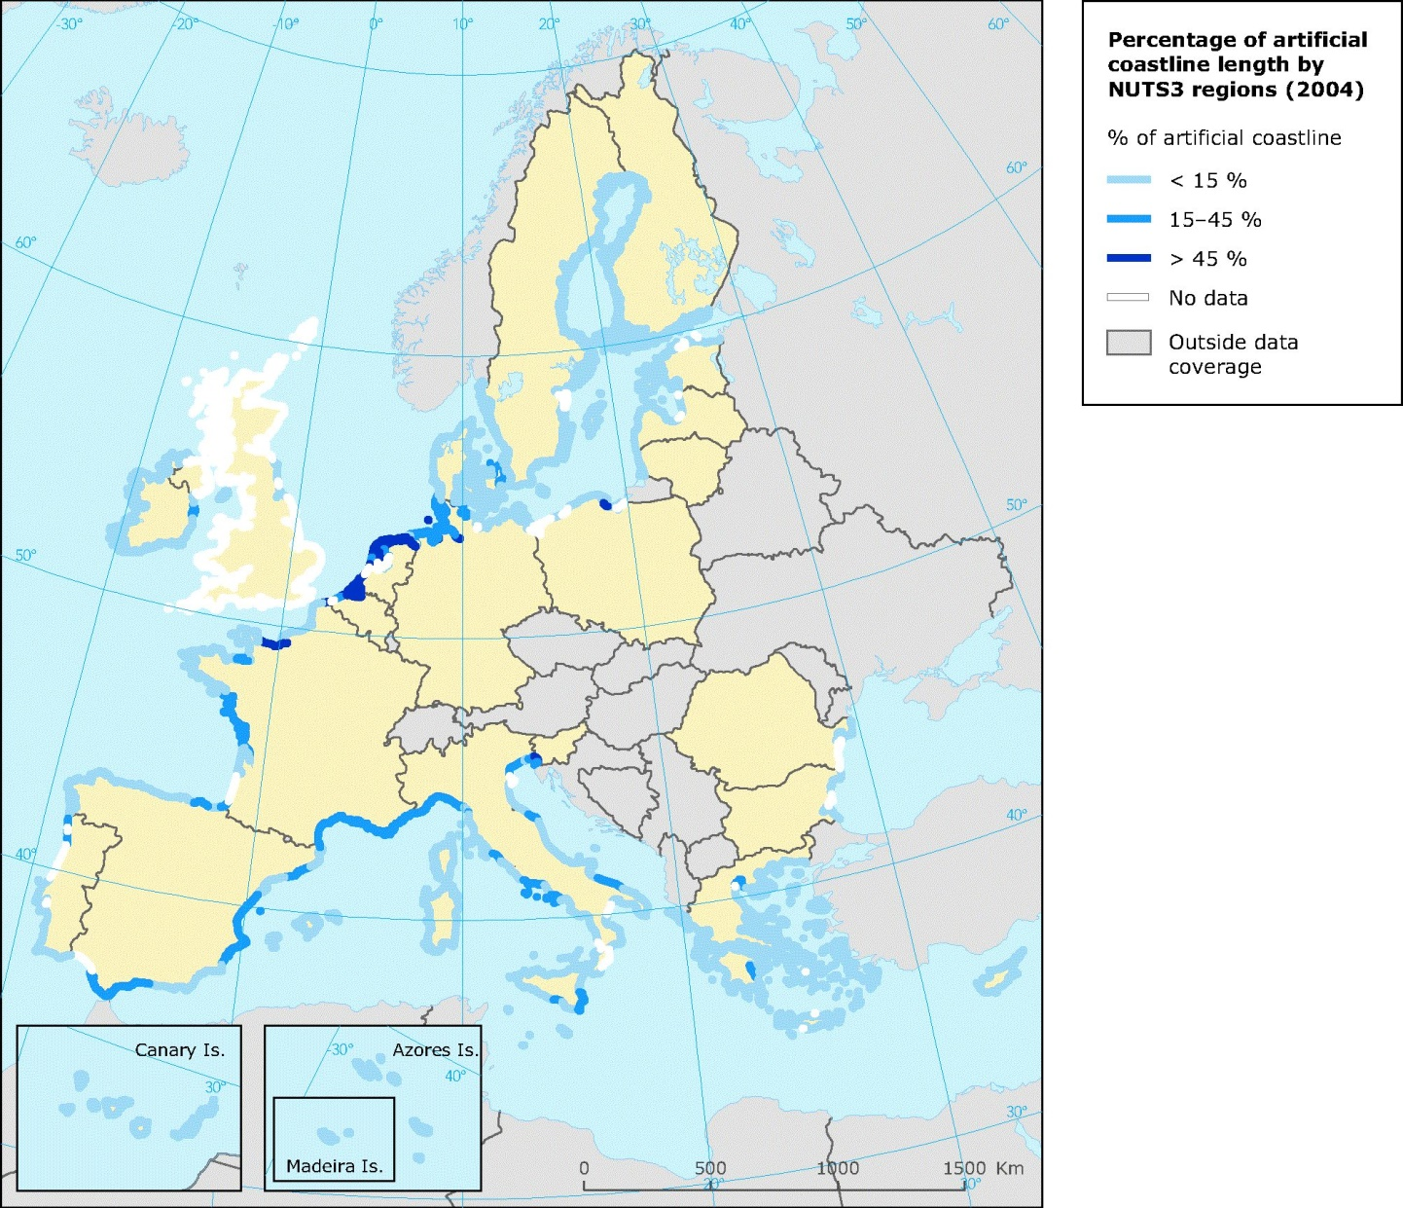
Population density in EU coastal zone
Percentage of artificial coastline
2
Slide numbers to be added
as shown alongside

Slide 3
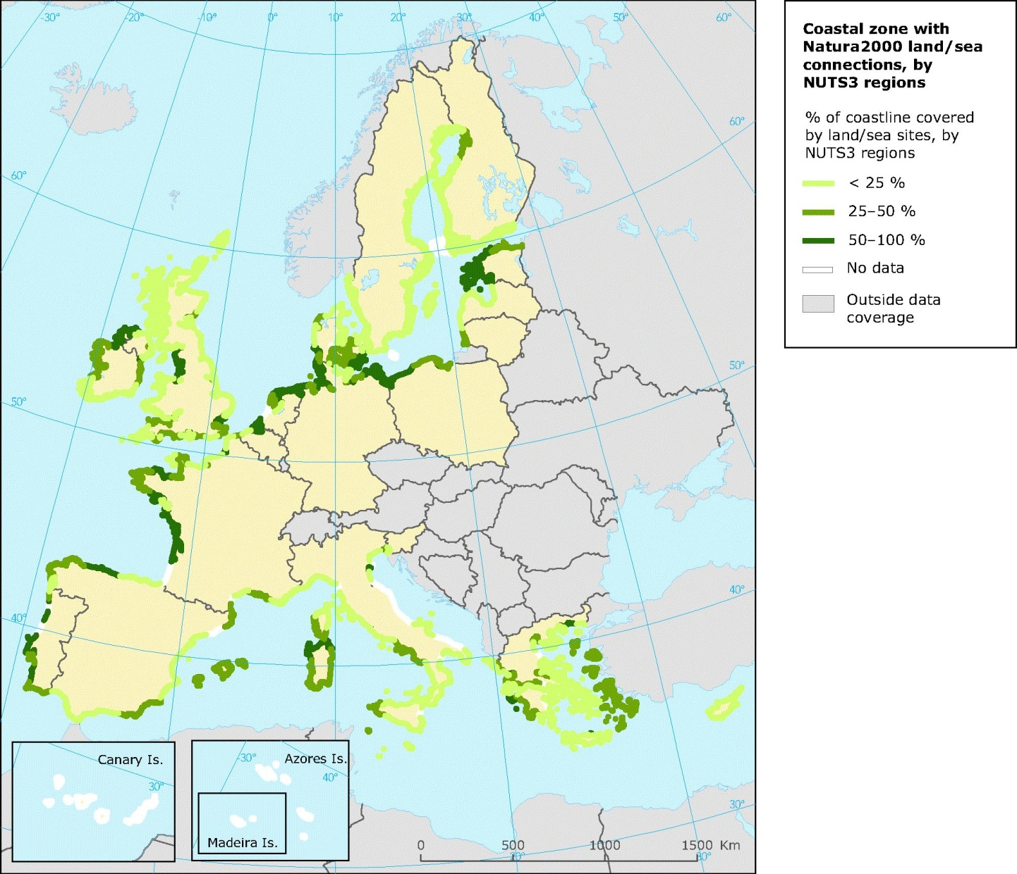
Percentage of coastline covered by land/sea Natura 2000 sites in 2006
3
Slide numbers to be added
as shown alongside

Slide 4
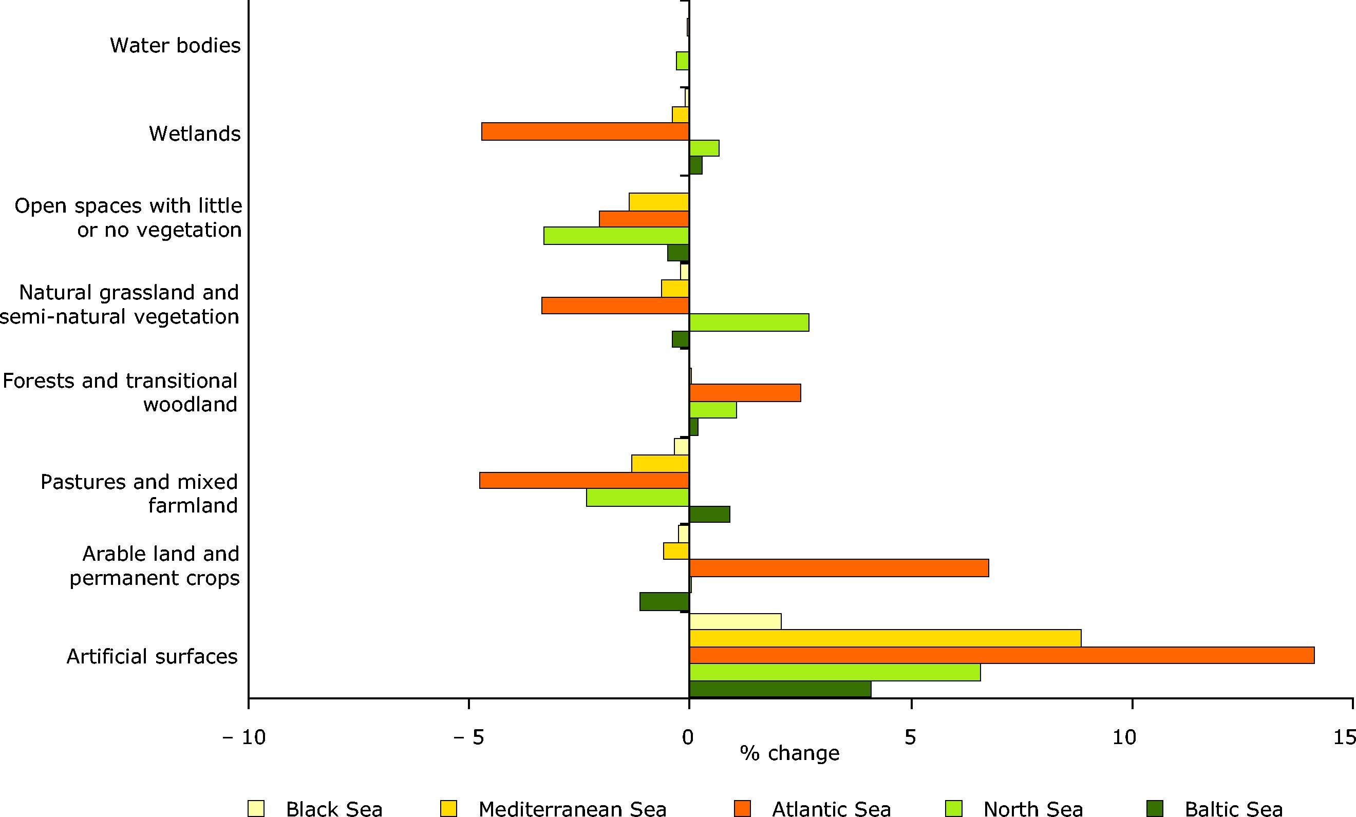
Land cover changes in 0-10 km coastal zone of European regional seas (1990-2000)
4
Slide numbers to be added
as shown alongside

Slide 5
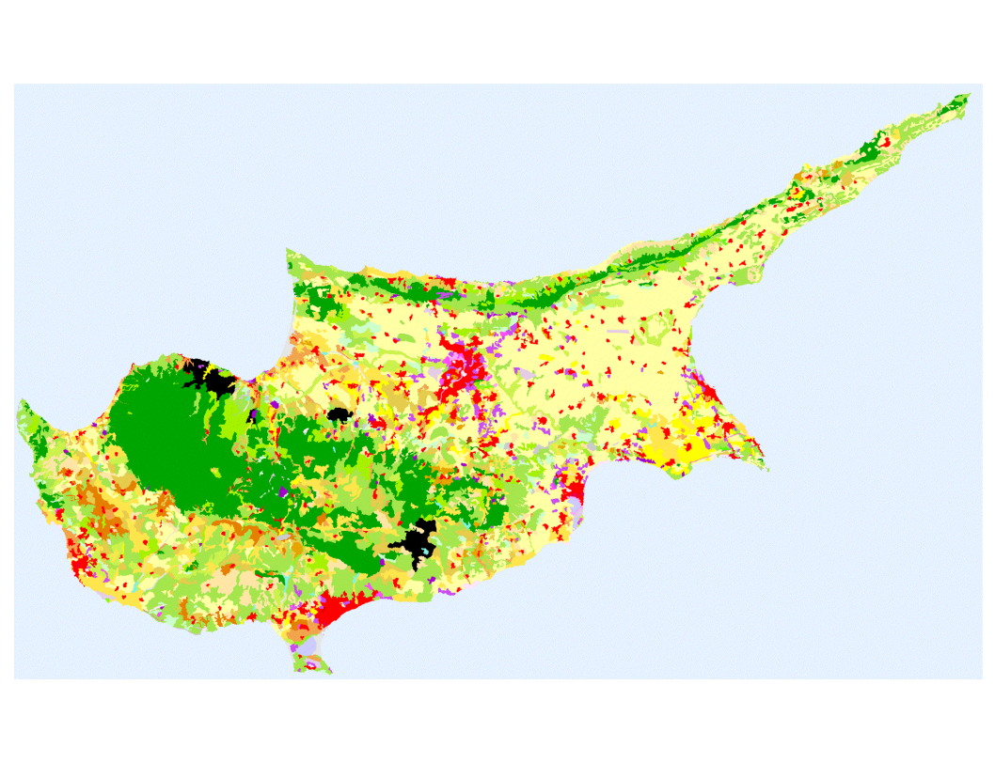
State of the coasts in Cyprus
The coastline covers 772km, of which the 296km (38%) is under the Cyprus Government control;
3 out of 4 cities are coastal;
50% of the total population lives and works in the coast;
90% of the tourist industry developed in coastal areas;
40-60% of GDP refers to coastal economic activities;
15 coastal areas designated as protected under the Natura 2000 network;
In 2019, 112 coastal bathing areas are being monitored under the EU Bathing Water Directive. 65 Blue Flag
5
Slide numbers to be added
as shown alongside

Slide 6
Type of the coastal zone | Length of the coastal zone in km | Percentage (%)
Urban coastal area | 90 | 30
Rural coastal area | 45 | 15
Tourism development | 106 | 36
Protected coastal area | 55 | 19
Length of coastal zone in the Republic of Cyprus | 296 | 100
British Sovereign Bases | 72
Coastal zone under occupation | 404
TOTAL OF CYPRUS | 772
State of the coasts in Cyprus
6
Slide numbers to be added
as shown alongside

Slide 7
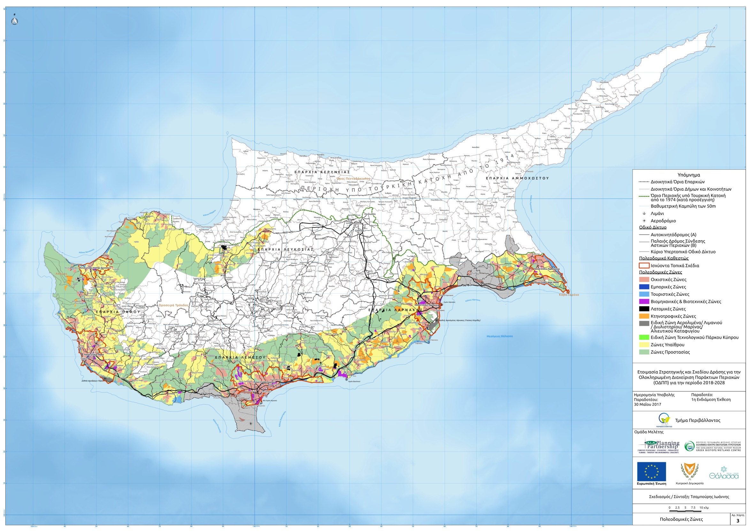
Coastal planning system in Cyprus
7
Slide numbers to be added
as shown alongside

Slide 8
Legislative framework of ICZM in Cyprus
ICZM Protocol in the Mediterranean, Department of Environment
2002 Recommendation of the European Parliament and Council on the implementation of the ICZM, Department of Environment
Law on Maritime Spatial Planning, Shipping Deputy Ministry
Marine Strategy Framework Directive, Department of Fisheries and Marine Research
Water Framework Directive, Department of Water Development, Department of Fisheries and Marine Research
Foreshore Protection Law, Ministry of Interior
Various pieces of legislation regarding permits for development / activities in the coastal areas
8
Slide numbers to be added
as shown alongside

Slide 9
2002 EU Recommendation of ICZM
Cyprus formulated national ICZM Strategies (2006-2008 & 2018-2030) and measures based on these strategies by following the principles of ICZM to ensure good coastal zone management:
Broad overall perspective
Long-term perspective
Adaptive management
Local specificity
Working with natural processes
Involving all the parties
Support and involvement of relevant administrative bodies
Use of a combination of instruments
9
Slide numbers to be added
as shown alongside

Slide 10
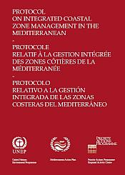
ICZM Protocol
7th Protocol of the Barcelona Convention
ICZM Protocol was signed in 21/1/2008 and entered into force in 24/3/2011
To date, 12 countries and the EU have ratified it.
“Integrated coastal zone management” means a dynamic process for the sustainable management and use of coastal zones, taking into account at the same time the fragility of coastal ecosystems and landscapes, the diversity of activities and uses, their interactions, the maritime orientation of certain activities and uses and their impact on both the marine and land parts.
“Coastal zone” means the geomorphologic area either side of the seashore in which the interaction between the marine and land parts occurs in the form of complex ecological and resource systems made up of biotic and abiotic components coexisting and interacting with human communities and relevant socio-economic activities.
10
Slide numbers to be added
as shown alongside

Slide 11
ICZM Protocol implementation in Cyprus
Cyprus implements the provisions of the ICZM Protocol:
Article 3: define the geographical coverage of the coastal zone (landward and seaward limit)
Articles 5&6: objectives and principles of ICZM were used in the National ICZM Strategy 2018-2030
Article 7: coordination among relevant authorities by establishing a Working Group in 2012
Article18: formulate a national strategy for ICZM and coastal implementation plans & programmes
Article 19: environmental assessment of plans, programmes and projects likely to have significant environmental effects on the coastal zones
Article 28: Transboundary coordination with Israel
11
Slide numbers to be added
as shown alongside

Slide 12
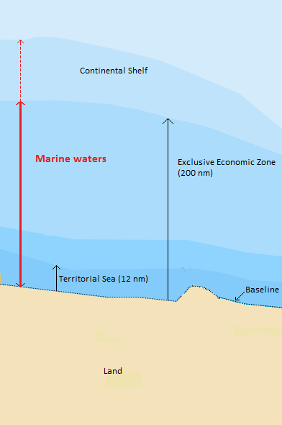
Geographical coverage of coastal zone In Cyprus
According to the ICZM Protocol, the area of the ICZM Strategy is:
the seaward limit of the coastal zone, which shall be the external limit of the territorial sea of Parties (12nm);
the landward limit of the coastal zone, which is defined by using environmental, economic and social criteria
DoE informed the public and any relevant actors of the geographical coverage defined, through workshops and newsletters.
Coastal zone
12
Slide numbers to be added
as shown alongside

Slide 13
Coastal planning system in Cyprus
Almost 50% of the land area adjacent to the coastline falls within the Planning Zone.
Category of Planning Zone | Length adjacent to the coastline inland (km) | Percentage of Total (%)
Protected Zones | 162 | 45
Agricultural Zones | 30 | 8,5
Touristic Zones | 110 | 31
Housing and Commercial Zones | 30 | 9
Industrial Zones | 10 | 3
Other Zones | 13 | 3,5
13
Slide numbers to be added
as shown alongside

Slide 14
Coordination among relevant authorities
In 2012, a Working Group on MSP was established that was enlarged in 2013 to incorporate ICZM.
The WG meets regularly to:
Recording of existing main economic activities, their pressures and risks and their social aspects in the coastal zone.
Participate in consultations with relevant stakeholders.
Integrated interactions between land and sea.
Defining the priorities, objectives and actions to achieve the ICZM Strategy.
Development of the ICZM Strategy
14
Slide numbers to be added
as shown alongside

Slide 15
Obstacles for an integrated coastal zone management in Cyprus
Various competent authorities involved in coastal zone management
Many pieces of legislation (national, EU) that deal with part of the issues of coastal management
Lack of an integrated approach for coastal management
No synergies between various policies
Strong pressure for coastal development
Conflict of land use – on the coastal zone
15
Slide numbers to be added
as shown alongside

Slide 16
Way forward to an integrated coastal zone management in Cyprus
Ratification of the ICZM Protocol
Approval of the National ICZM Strategy, following an agreement on the proposed governance structure
Implementation of the ICZM Action Plan up to 2030, having defined and agreed upon the environmental and financial cost of the 40 actions
Development of a Transboundary CAMP between Cyprus and Israel
Monitoring Progress
16
Slide numbers to be added
as shown alongside

Slide 17
Ευχαριστώ πολύ
DEPARTMENT OF ENVIRONMENT - http://www.moa.gov.cy/moa/environment
Photo credit to be given
as shown alongside
(in black or in white)

