Slide 1
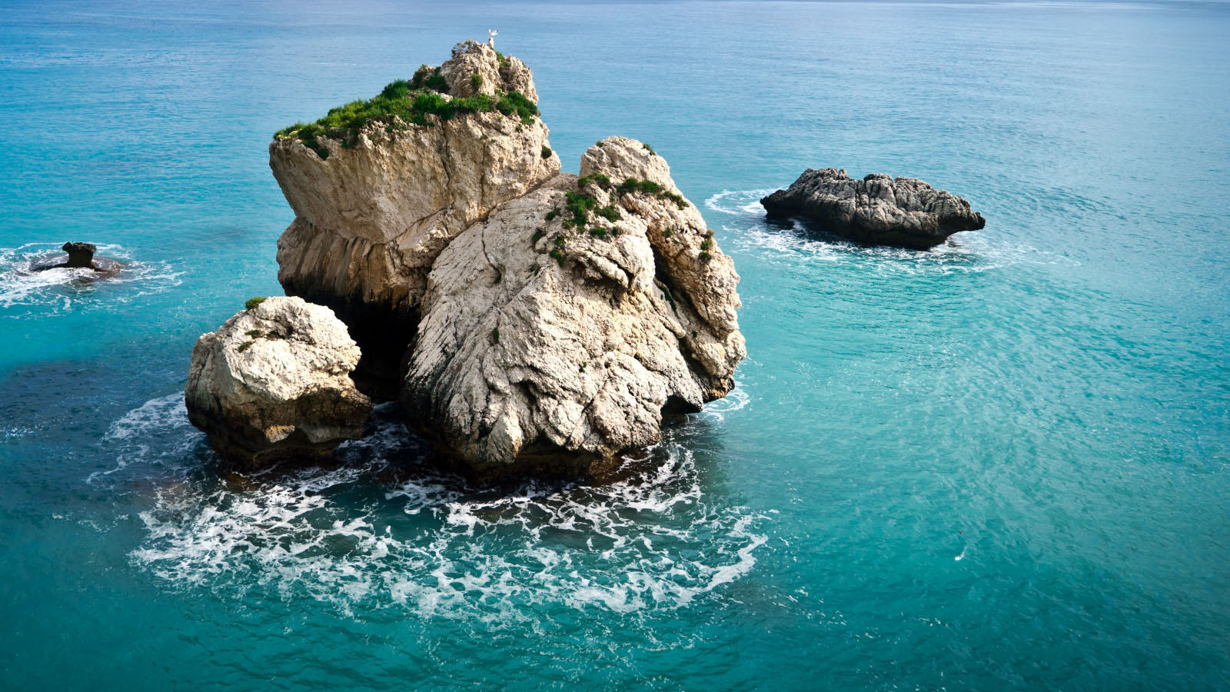
GEF ADRIATIC PROJECT
By: Anis Zarrouk (SPA/RAC)
Marina Marković (PAP/RAC)
Meeting of PAP/RAC Focal Points, 24-25 May 2021

Slide 2
The GEF Adriatic project
Funded by the GEF (International Water and Biodiversity focal areas - GEF 6 Strategy)
Implemented by the UNEP/MAP Coordinating Unit with PAP/RAC and SPA/RAC in coordination with the Ministry of Tourism and Environment, the National Agency for Protected Areas in Albania and the Ministry for Ecology, Spatial Planning and Urbanism in Montenegro
2018-2021
The project proposes to integrate the Ecosystem Approach into management tools such us MSP, ICZM, MPAs, and to provide technical assistance to Albania and Montenegro to strengthen their respective management capacity.

Slide 3
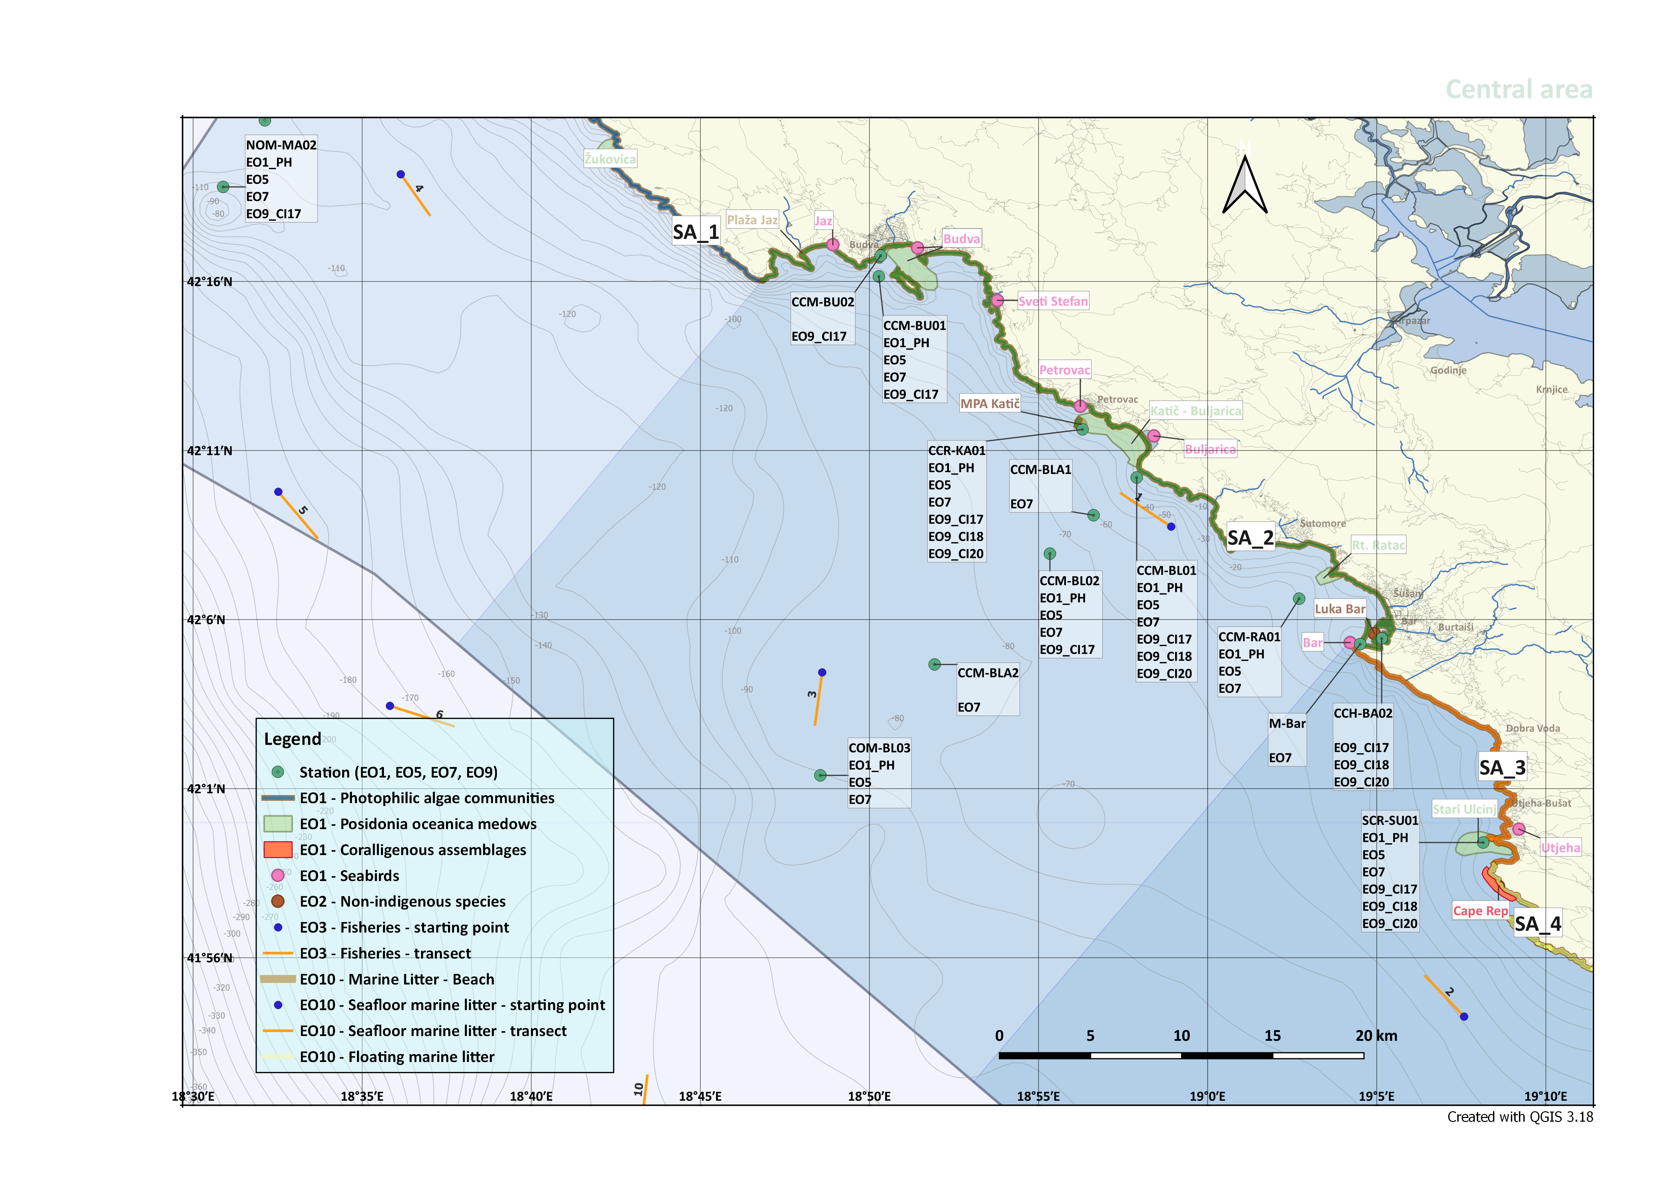
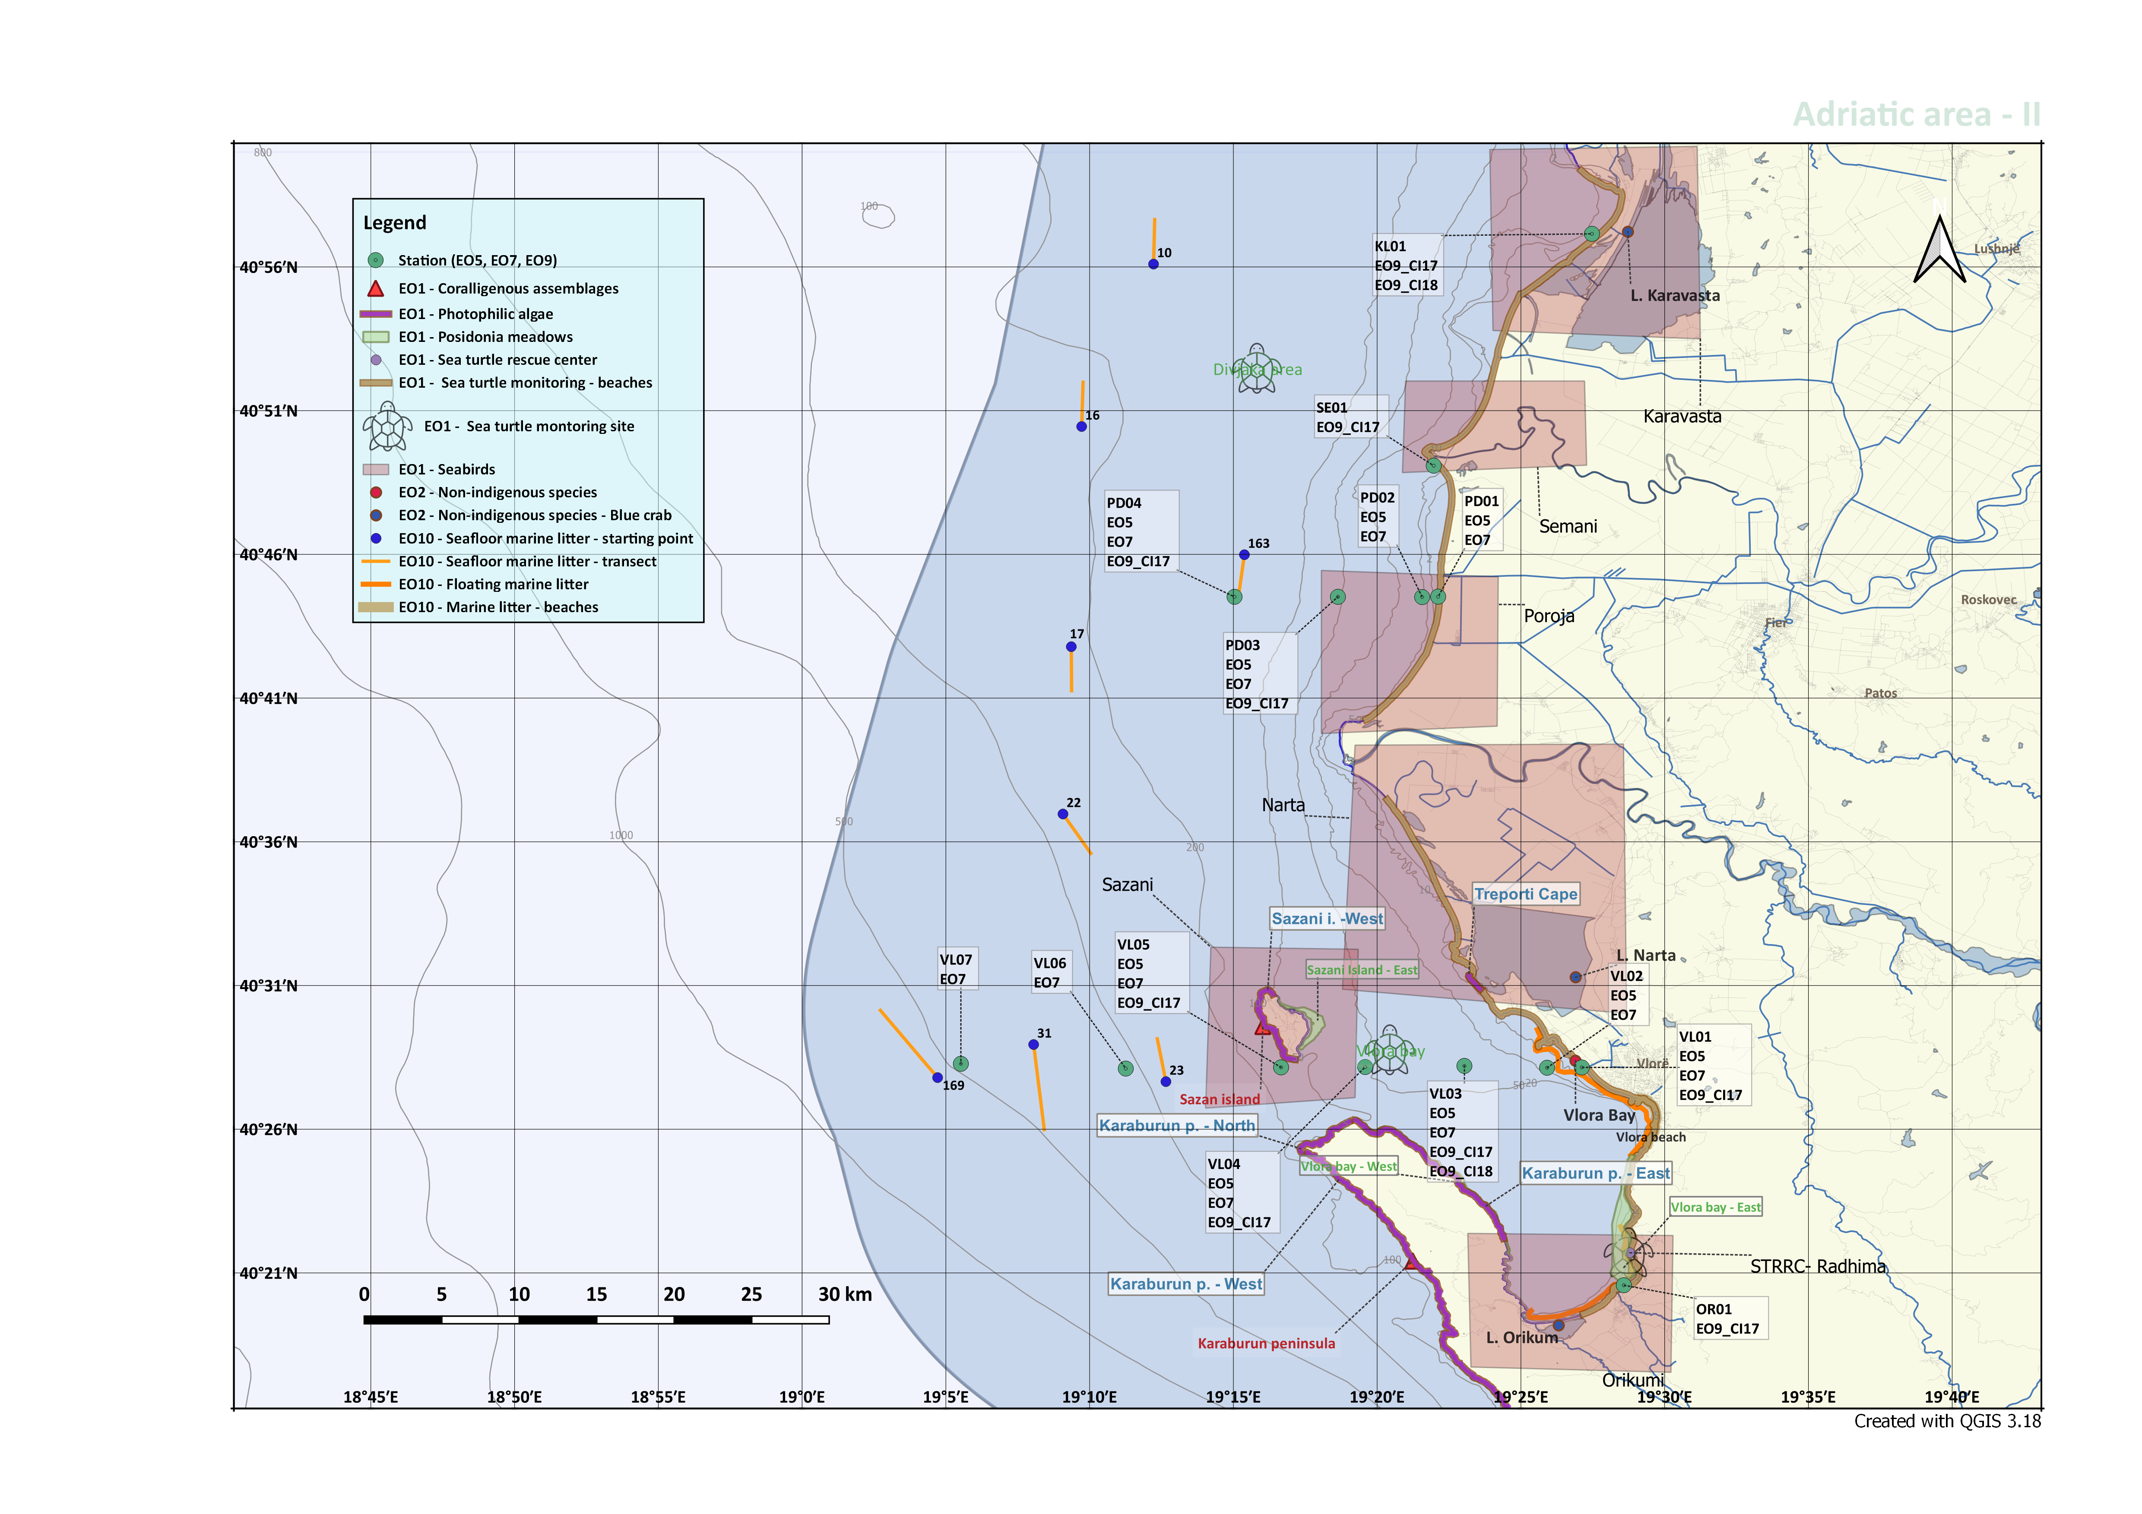
THE INTEGRATED MONITORING AND ASSESSMENT PROGRAMME (IMAP)
Int/National Experts team
Gap assessement
International / national experts collaboration/involvement during the whole process

Slide 4
THE INTEGRATED MONITORING AND ASSESSMENT PROGRAMME (IMAP)
Lesson learned: The whole is greater then the sum of its parts

Slide 5
THE INTEGRATED MONITORING AND ASSESSMENT PROGRAMME (IMAP)
Among the first IMAP surveys in the Mediterranean

Slide 6
THE INTEGRATED MONITORING AND ASSESSMENT PROGRAMME (IMAP)
GIS MAPS (SPA/RAC MBP Platform)
IMAP info System platform
National Databases

Slide 7
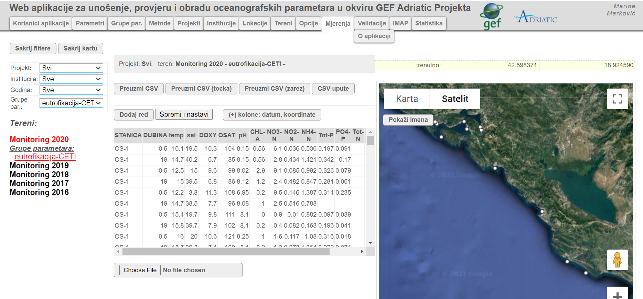
THE INTEGRATED MONITORING AND ASSESSMENT PROGRAMME (IMAP)

Slide 8
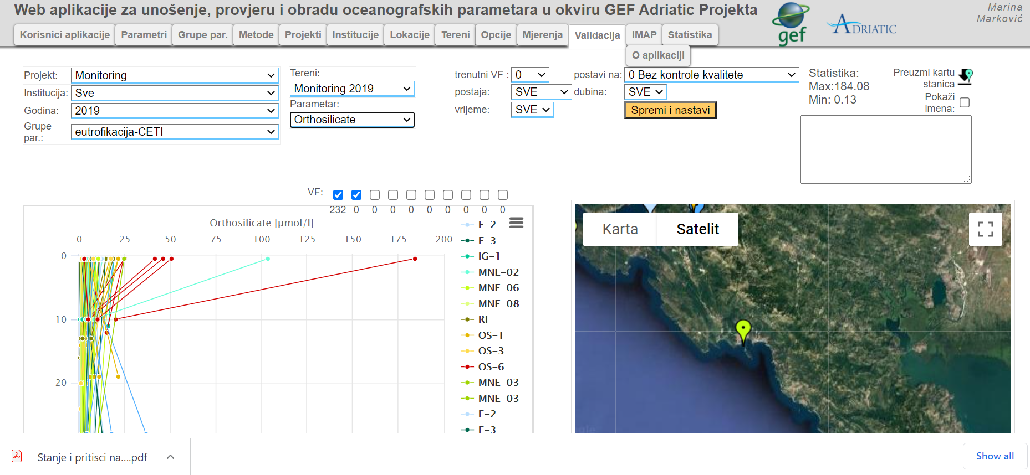
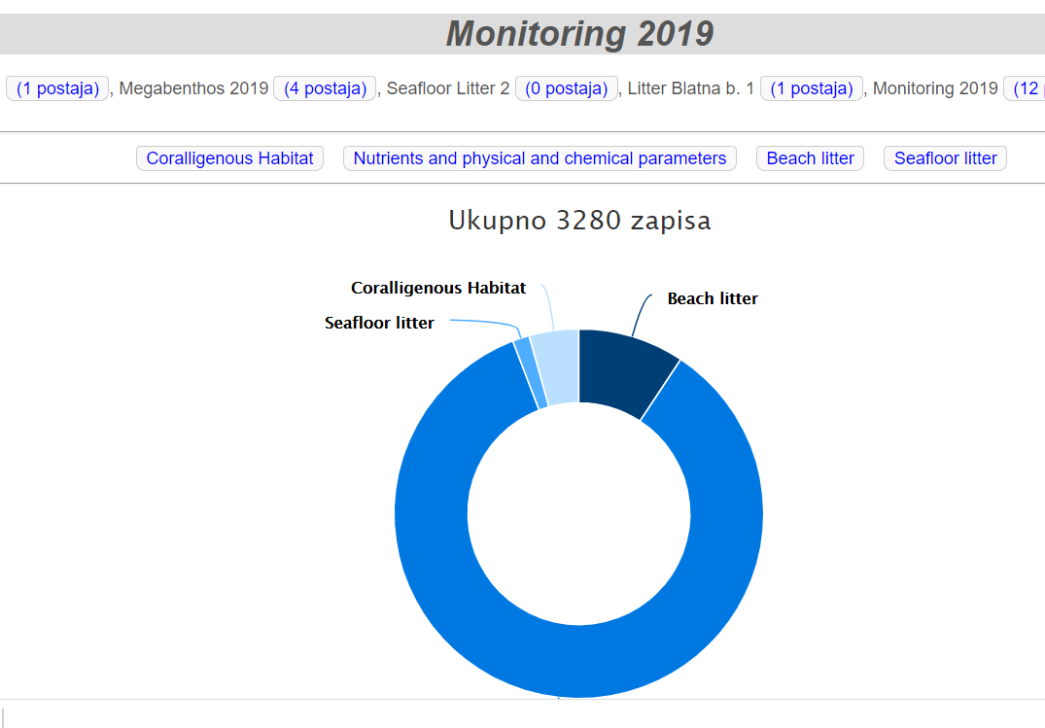

Slide 9
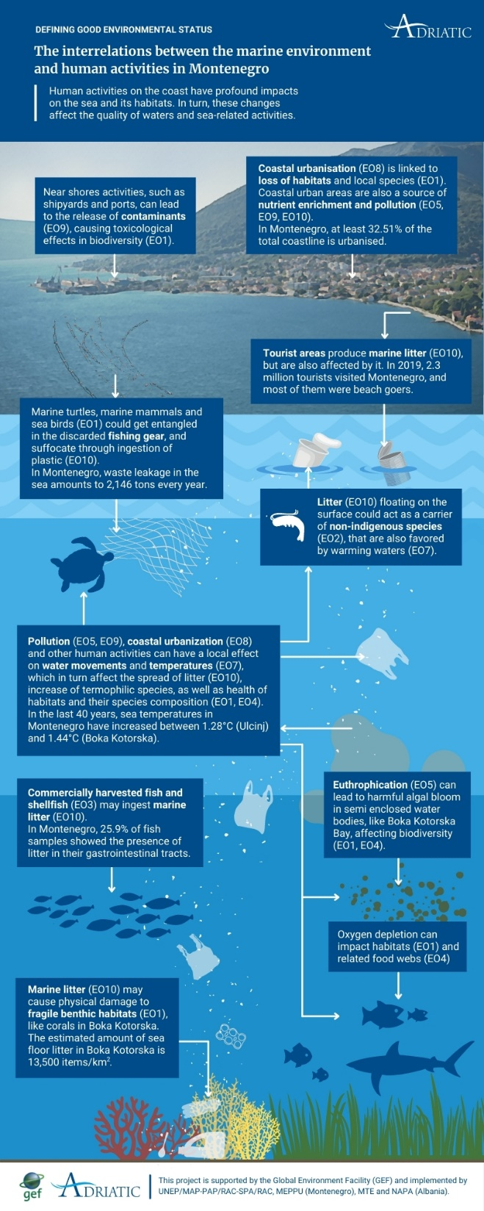
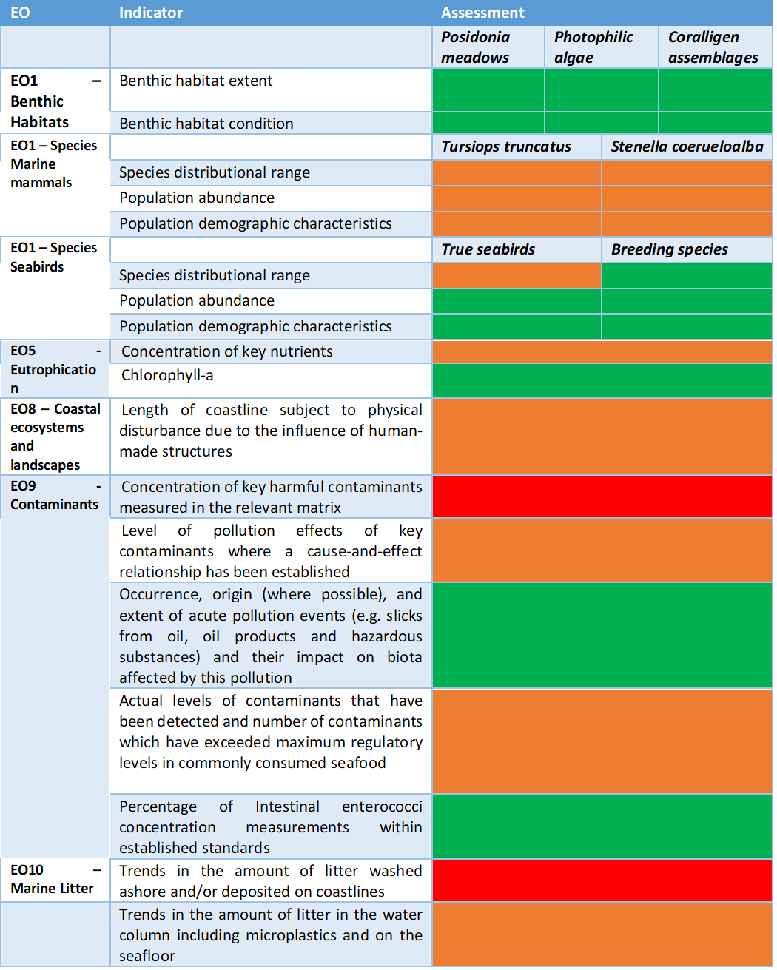

Slide 10
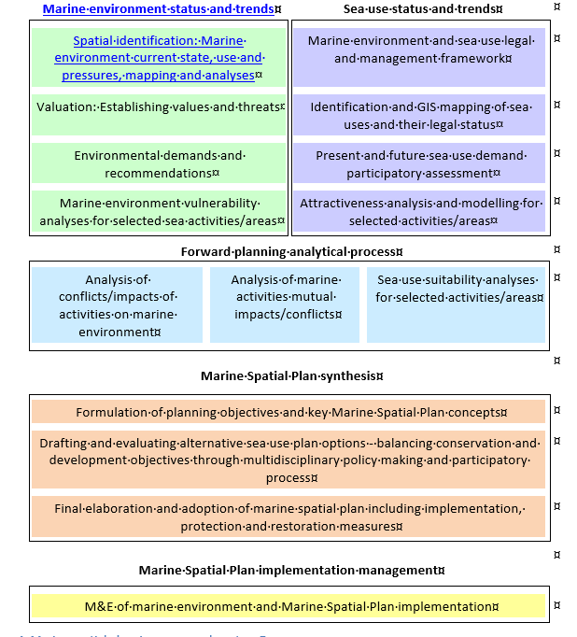
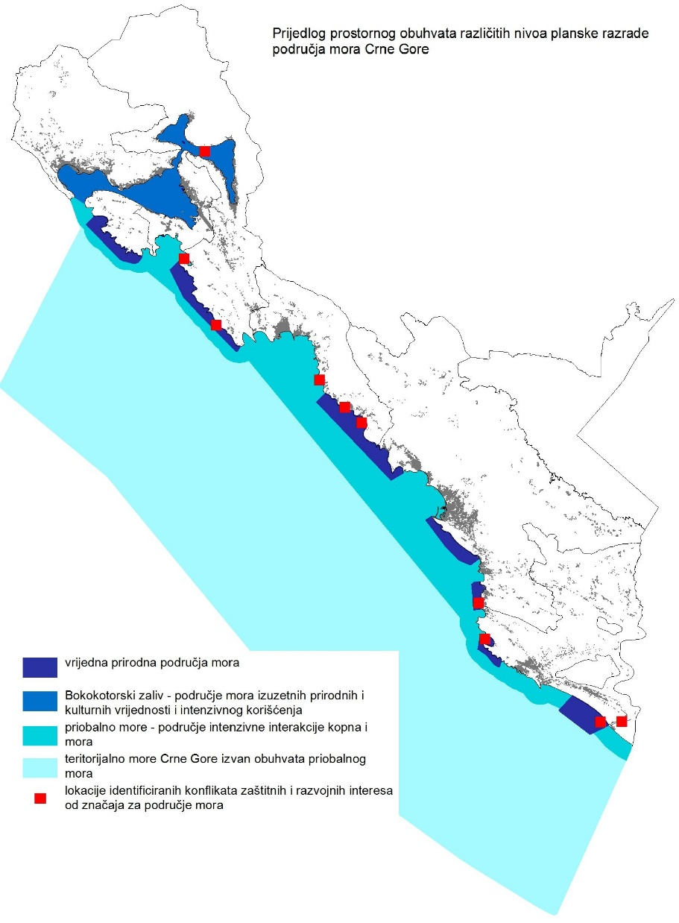
MARINE SPATIAL PLANNING

Slide 11
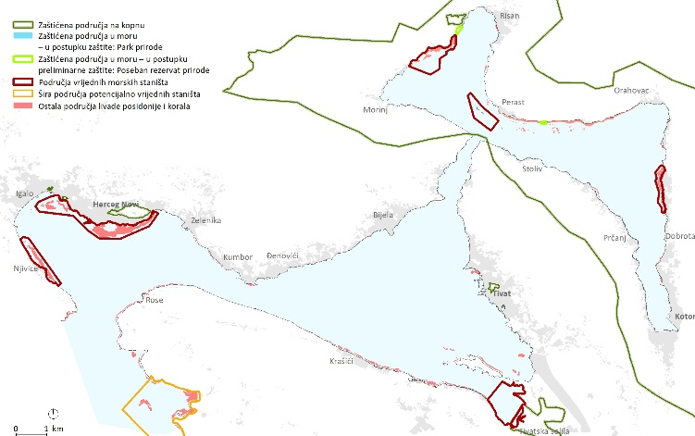
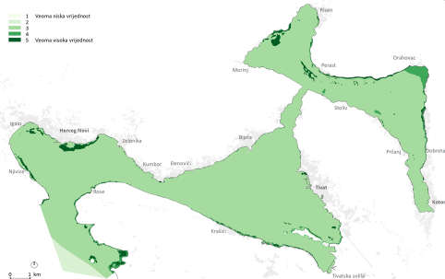
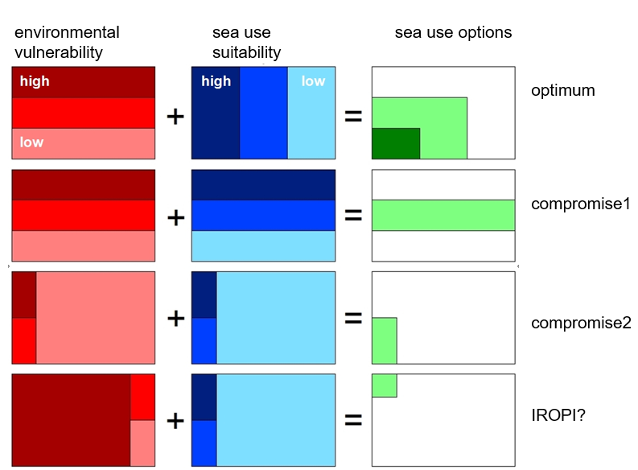
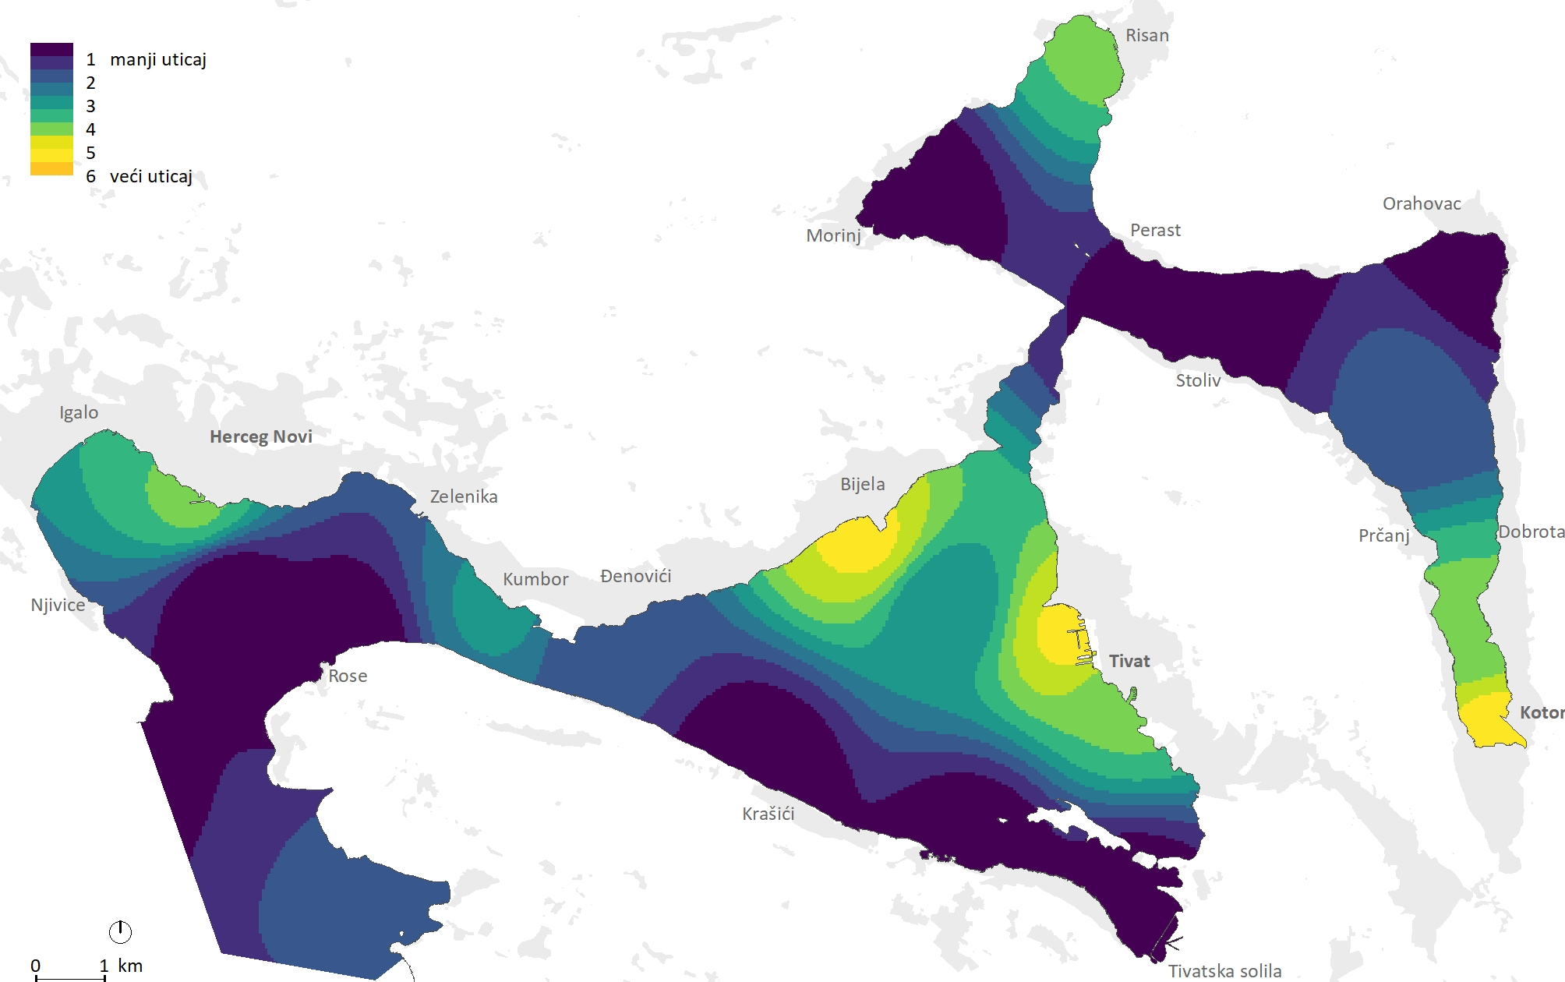
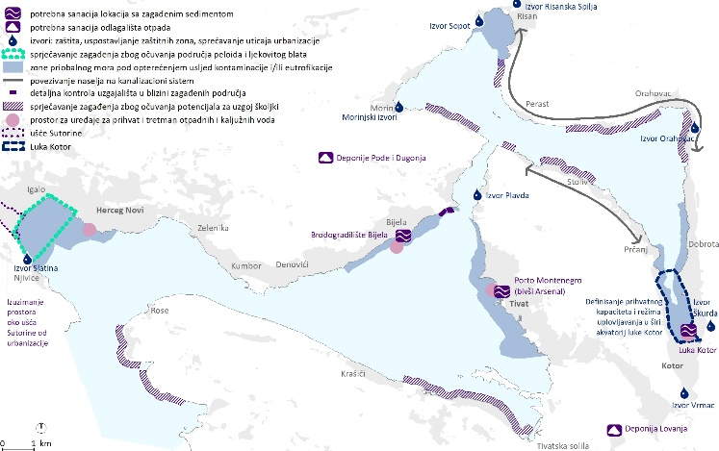
MARINE SPATIAL PLANNING - ECAP
ECAP
Asses
Define ideal state
Set targets
Monitor
Implement
MSP

Slide 12
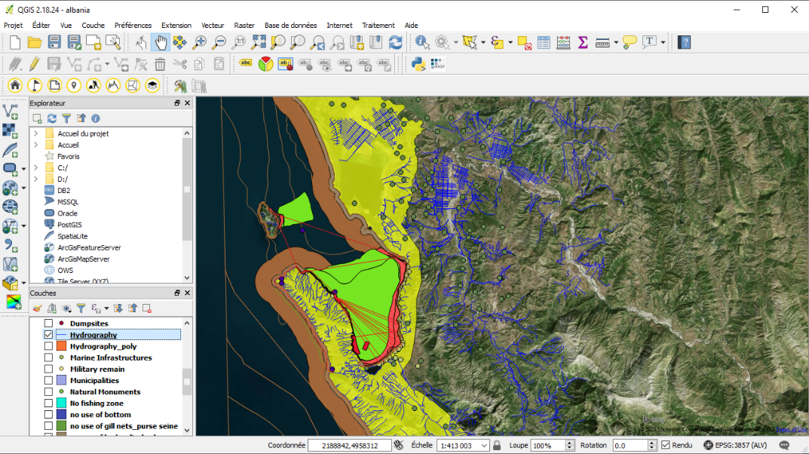
MARINE SPATIAL PLANNING – SYNERGIES WITH GEF ADRIATIC
Synergies with Cooperation Agreement between IMELS and UNEP/MAP (MSP Pilot Project)
……… EcAp MED III, IMAP/MPA

Slide 13
Thanks to all who contributed to GEF Adriatic project
Aleksandra Ivanović
Ana Mišurović
Elisabetta Tola
Rezart Kapedani
Damir Ivanković
Genc Myftiu
Ivica Trumbić
Simone Modugno
Ana Pešić
Assia Barić
Saša Karajović
Nada Krstulović
Danijela Šuković
Nika Cigoj
Mihailo Jovičević
Elson Salihaj
Igli Pustina
Slobodan Pavasović
Aleš Mlakar
Zamir Dedej
Dragan Marković
Ornela Cucci
Valbona Simixhiu
Aneta Kankaraš
Alfred Velaj
Mia Laušević
Aurora Roni
Marco Zanatello
Ivana Stojanović
Milica Mašanović
Gojko Berlengi
Danijela Joksimović
Milena Bataković
Novica Mijović
Mirko Đurović
Sajmir Beqiraj
Lefter Kashta
Ana Štrbenac
Darinka Joksimović
Vladimir Živković
Jelena Knežević
Luka Čalić
Alain Jeudy de Grissac
Grozdan Kušpilić
Raimonda Lilo
Milica Mandić
Ivana Mitrović
Veljko Popović
Slađana Gvozdenović
Edlira Baraj
Olivier Brivois
Egidio Trainito
Marco Zanatello
Ledia Abazi
Luca Sardi
Ivan Guala
Eduard Cani
Carlo del Grande
Vesna Mačić
Enerit Sacdanaku
Ferdinand Bego
Magdalena Cara
Andrea Roman
Mišo Komenda
Nemanja Malovrazić
Ubaldo Pantaleo
Denisa Xhoga
Giordano Giorgi
Radovan Kandić
Branka Grbec
Yakup Kaska
Genti Kromidha
Carlos Guitard
Odhise Zoto
Klodiana Marika
Robert Precali
Arthur Pasquale
Marco Palma
Petrit Llaveshi
Ubaldo Pantaleo
Arjana Ylli
Darko Saveljić
Željko Lompar
Slavica Petović
Chantal Menard
Christos Ioakemidis
Hamdi Beshku
Aleksandar Jokismović
Ivica Đurđević Tomaš
Željka Čurović

Slide 14
Thank you!

