Slide 1
Towards a transboundary CAMP project for Cyprus and Israel
Joanna CONSTANTINIDOU & Maayan HAIM / Ayia Napa, 25 September 2019
Photo credit to be given
as shown alongside
(in black or in white)

Slide 2
Introduction
2018: Following the consultation of National Focal Points in Cyprus and Israel, UN Environment/MAP and PAP/RAC decided to explore the possibility and opportunity of preparing and implementing a Transboundary CAMP project.
2019: The Cyprus Ministry of Agriculture, Rural Development and Environment and Israel Ministry of Environmental Protection expressed the interest to prepare a Feasibility Study to investigate the opportunity of developing a project of transboundary cooperation between the countries.
2
Slide numbers to be added
as shown alongside

Slide 3
Coastal Area Management Programme (CAMP)
CAMP is a programme which is part of the Mediterranean Sea protection activities undertaken by the Contracting Parties to the Barcelona Convention. It is focused on the implementation of coastal management projects developed for pilot areas located in the Mediterranean.
Transboundary CAMP aims to “promote cross-border harmonisation of coastal management and common approaches towards implementation of obligations” under the provisions of the Integrated Coastal Zone Management Protocol (article 28) and EU Directives.
3
Slide numbers to be added
as shown alongside

Slide 4
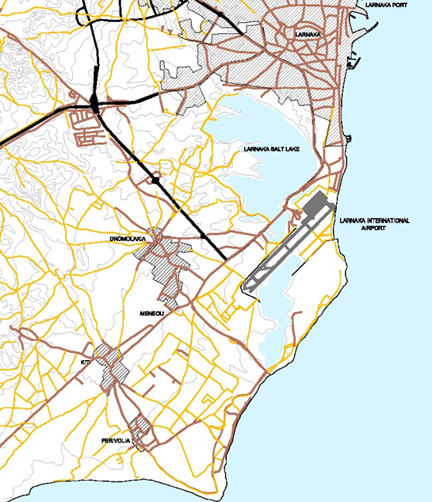
CAMP Cyprus 2006-2008
CAMP Cyprus implemented by UNEP/MAP and the Government of Cyprus (DoE) and was the first national coastal strategy.
It covers the whole coast of Cyprus and incorporates a local spatial dimension of the southern peri-urban coastal area of Larnaca.
The main characteristics of CAMP Cyprus include:
priority to the specific problems and the institutional and policy context of Cyprus.
focus on policy problems that account for existing gaps in the management in coastal areas.
propose solutions and changes towards making coastal areas management integrated and effective.
4
Slide numbers to be added
as shown alongside

Slide 5
Outcomes of the CAMP Cyprus 2006-2008
Adoption and application of the proposed ICAM Strategic Framework within the context of the Island Plan.
Use of environmental awareness methods similar to Imagine by the Departments involved in coastal management.
Development and application of a coastal and marine Biodiversity Strategy as part of the ICAM.
Incorporation of the SEA process in the spatial planning system.
Incorporation of the tool of Carrying Capacity Assessment in the spatial planning system and tourism policies / strategies.
Incorporation of Environmental Economics in the spatial planning process, tourism measures and environmental policy.
5
Slide numbers to be added
as shown alongside

Slide 6
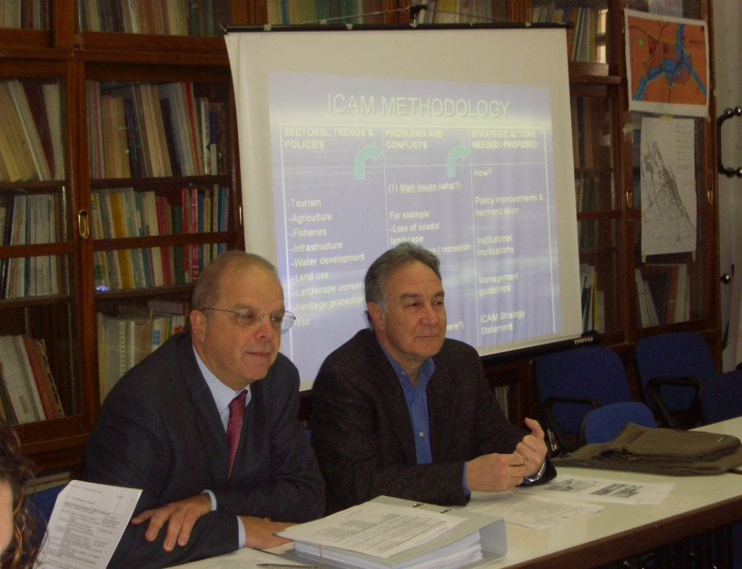
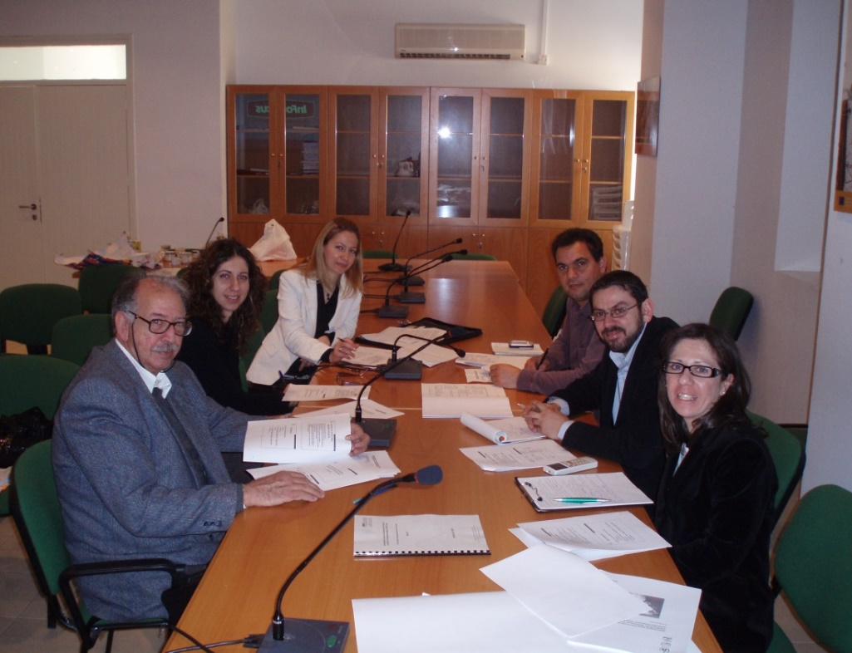
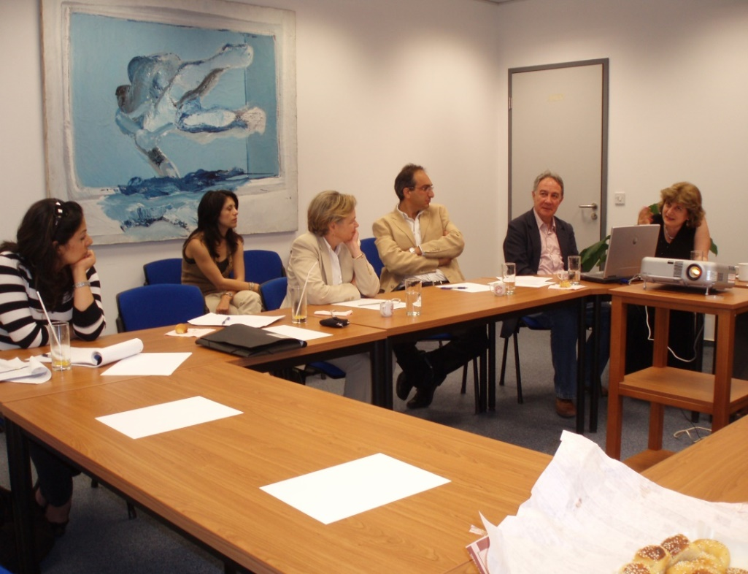
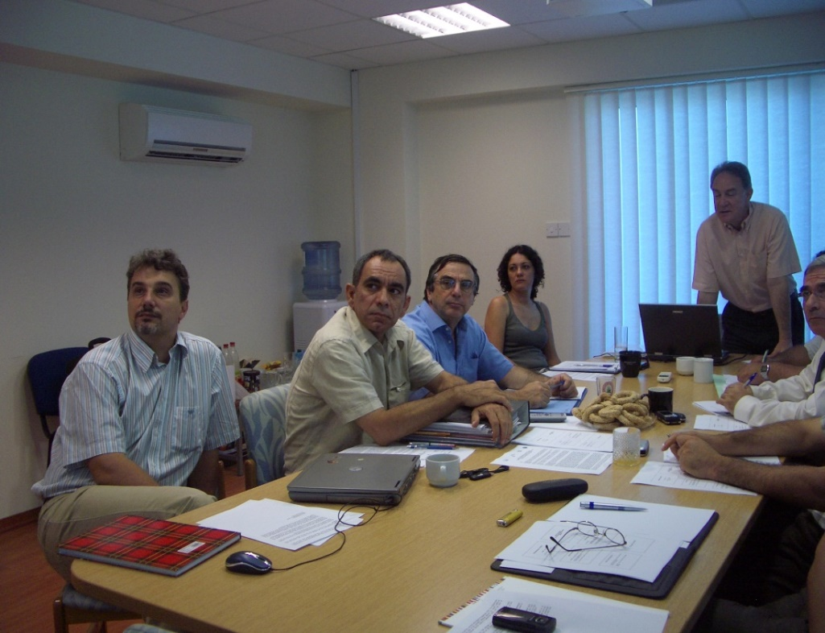
ICAM workshop 27/01/2007
Imagine workshop 20/02/2007
Env. Econ. workshop 15/05/2007
SEA workshop 04/07/2007
6
Slide numbers to be added
as shown alongside

Slide 7
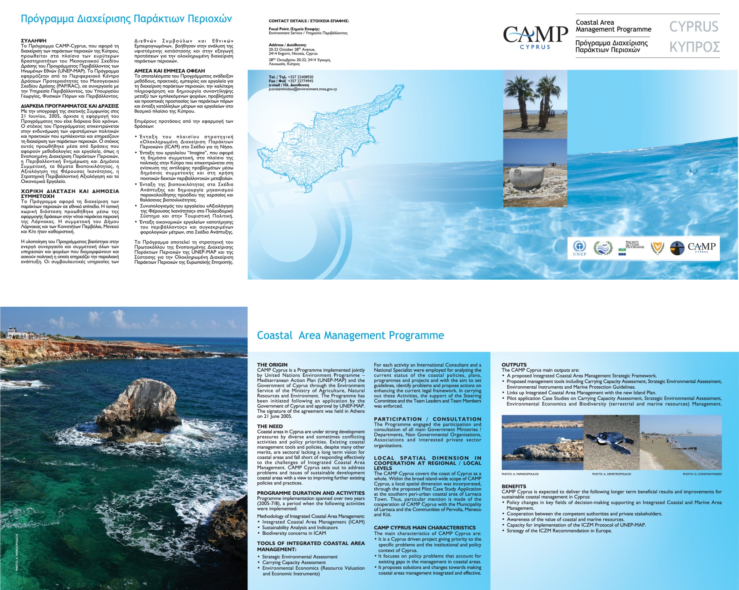
CAMP Cyprus
http://www.moa.gov.cy/moa/environment
7
Slide numbers to be added
as shown alongside

Slide 8
Follow up of CAMP: ICZM Strategy for Cyprus 2018-2030
ICZM Strategy for Cyprus 2018-2030 is the second strategy for the coastal management, which incorporated the outcomes of CAMP Cyprus. It’s vision is:
Development of the coastal zone of Cyprus, with a time horizon of 2030, within the framework of the principles of sustainable development, ensuring:
social well-being and security;
balanced economic development;
preservation of its ecosystems and their capacity to provide goods and services;
highlighting its historical and cultural wealth.
8
Slide numbers to be added
as shown alongside

Slide 9
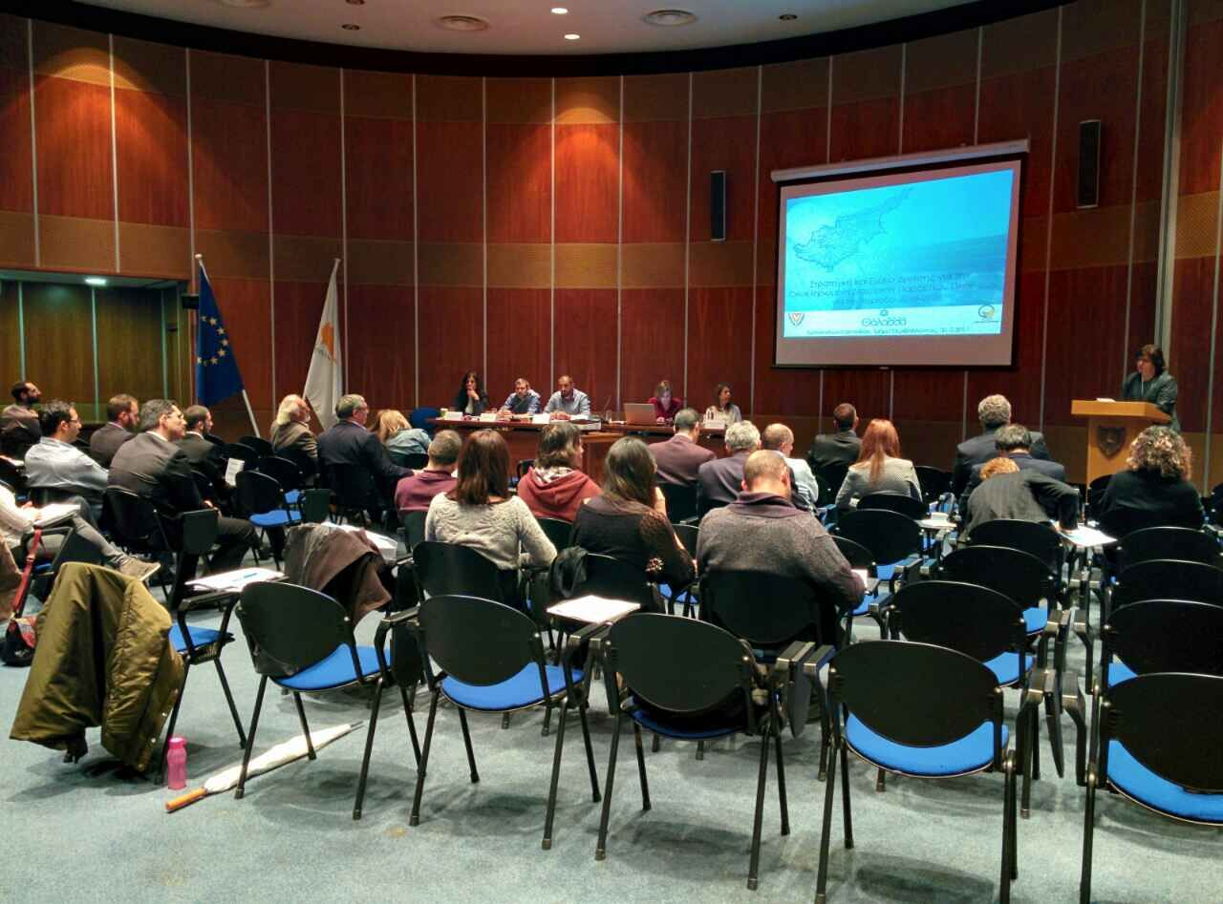
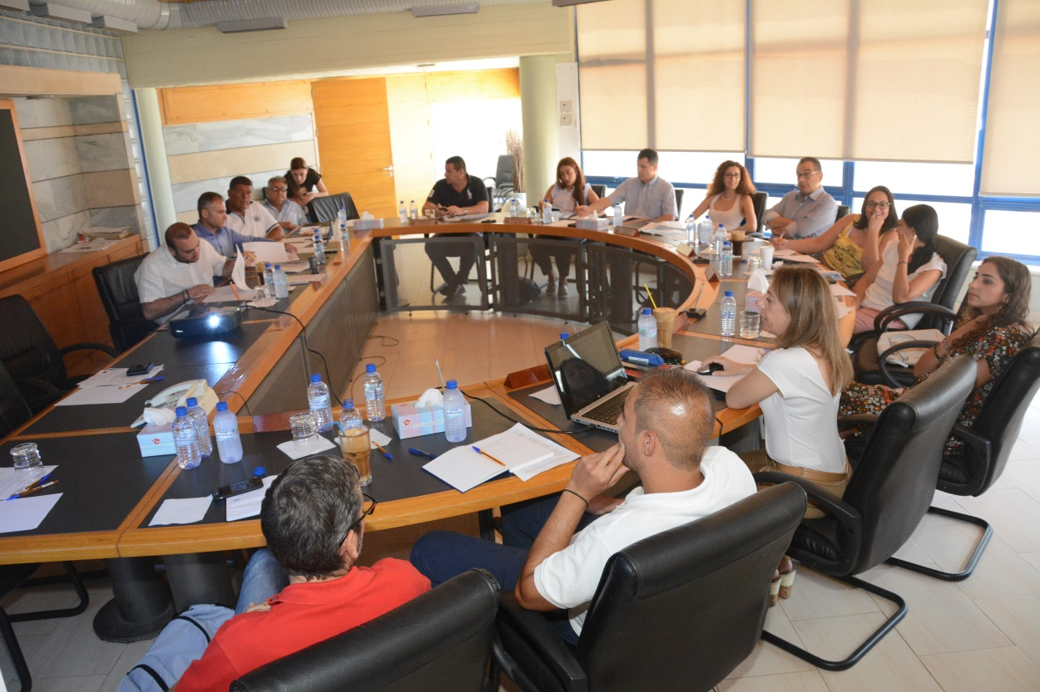
ICZM Strategy for Cyprus 2018-2030
ICZM presentation 31/3/2017
ICZM presentation 16/6/2017
9
Slide numbers to be added
as shown alongside

Slide 10
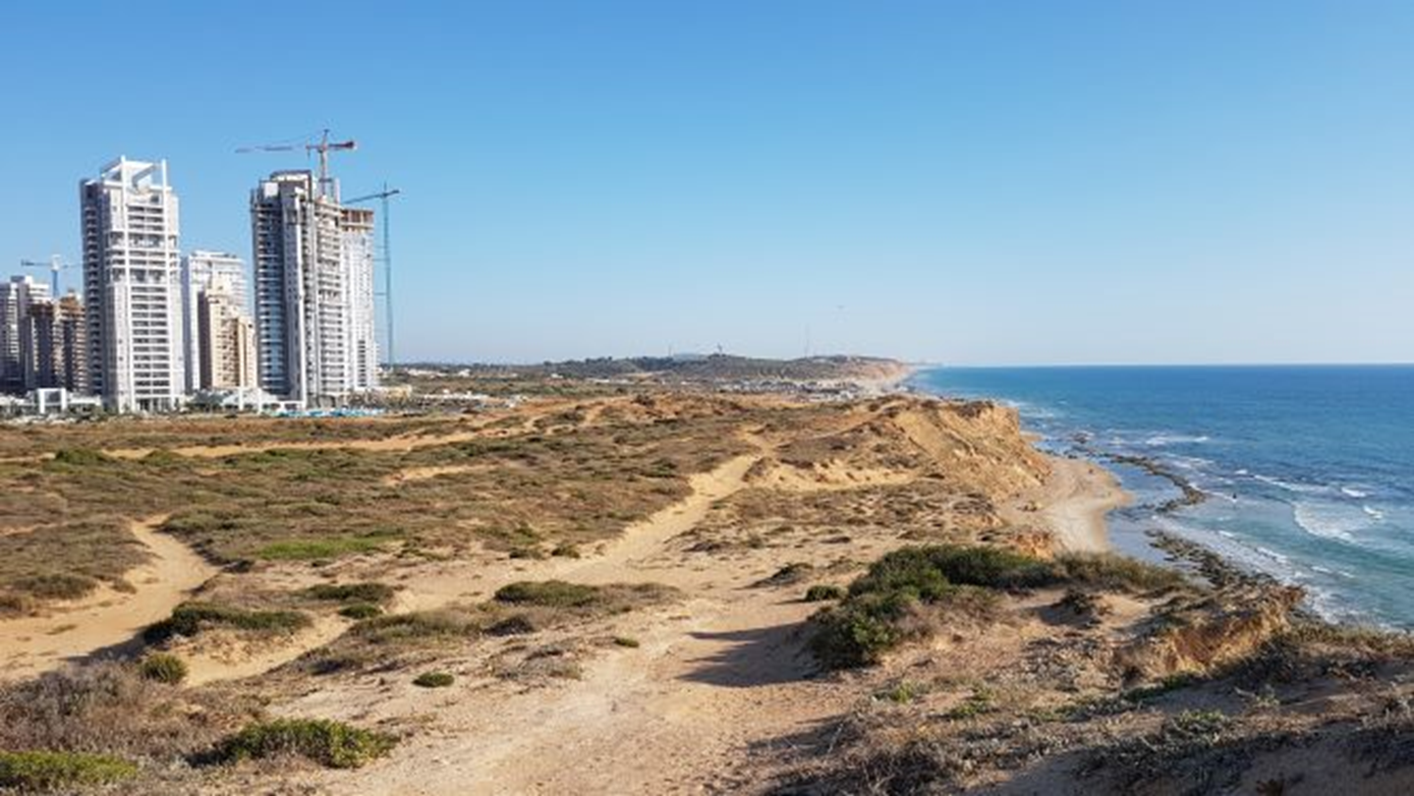
CAMP Israel (1996 – 2000)
Land Area: 22,000 sq.km
Coastline Length: 190 km
Territorial waters: 4,060 sq.km
EEZ: 26,000 sq.km
10
Slide numbers to be added
as shown alongside

Slide 11
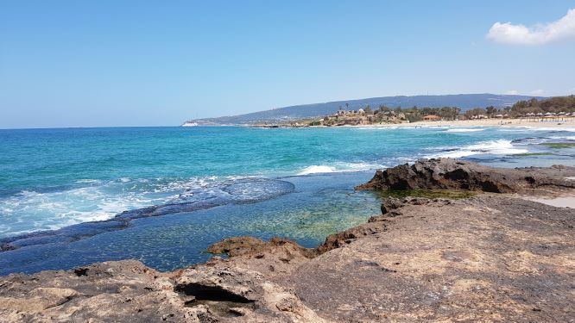
CAMP Israel (1996 – 2000)
CAMP Israel was oriented at the creation and promotion of the process of integrated planning and management through six interrelated activities, as follows:
First National Strategy for Sustainable Development;
Assessment and control of pollution;
Management of coastal resources and hazards;
Economic instruments;
Remote sensing; and
Coastal area management.
11
Slide numbers to be added
as shown alongside

Slide 12
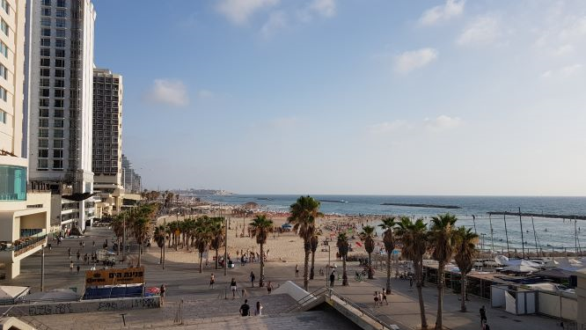
CAMP Israel (1996 – 2000)
Several of the CAMP activities proposed relate to the country as a whole, not just to the coastal area or a part of the coastal area.
Policies for effective coastal management were proposed, which should be based on a holistic approach and specific expertise in a wide variety of disciplines, and backed up by effective information processing and by investigations of potential regulative and economic instruments for implementation.
Several of the CAMP activities proposed relate to the country as a whole, not just to the coastal area or a part of the coastal area.
Policies for effective coastal management were proposed, which should be based on a holistic approach and specific expertise in a wide variety of disciplines, and backed up by effective information processing and by investigations of potential regulative and economic instruments for implementation
12
Slide numbers to be added
as shown alongside

Slide 13
Legal aspects of the sea of Cyprus and Israel
Both countries have a 12nm Territorial Sea and established an Exclusive Economic Zone (EEZ) and Continental Shelf among them (2010)
Memorandum of Understanding in the energy (2013)
Agreement on cooperation in the development of cross border resources discovered (oil & gas reservoirs)
Agreement in the field of environmental protection (2014)
Two more agreements were signed on electricity project (EuroAsia Interconnector) and gas pipelines (EastMed)
Implementation Agreement on the Sub-Regional Marine Oil Pollution Contingency Plan (2018)
13
Slide numbers to be added
as shown alongside

Slide 14
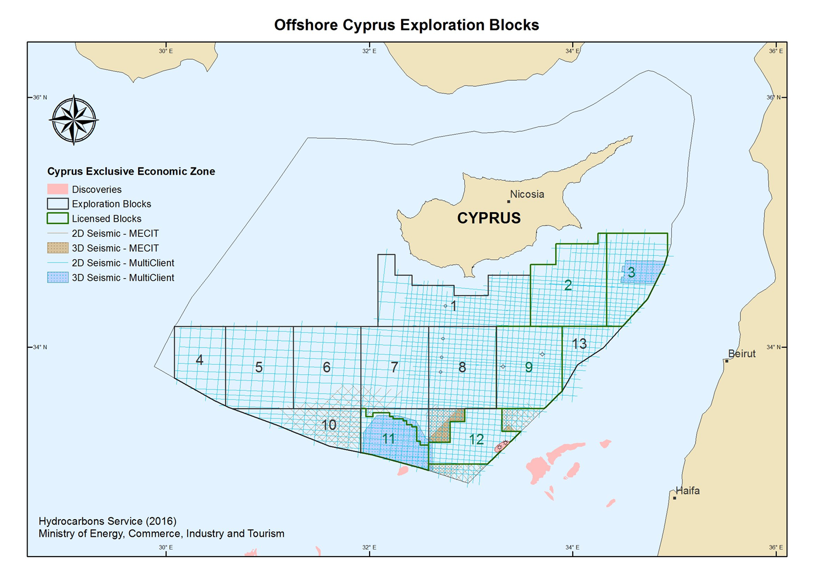
Map of the EEZ of Cyprus and Israel
To be inserted
14
Slide numbers to be added
as shown alongside

Slide 15
Legal aspects of the coastal zone of Cyprus
Ratification of the UNCLOS in 1988
Signature / ratification of the Barcelona Convention (1978)
No signature / ratification of the ICZM Protocol – implementation of some provisions
National ICZM Strategy 2018-2030 (pending approval) – definition of the landward limit of the Coastal Zone
Foreshore Protection Law (Cap. 58)
Maritime Spatial Planning (MSP) Law (2017)
15
Slide numbers to be added
as shown alongside

Slide 16
Legal aspects of the coastal zone of Israel
Maritime Zones Bill (in process)
Signature (2008) and ratification (2016) of the ICZM Protocol
New National Master Plan for the coastal area (to be approved)
Law for the Protection of the Coastal Zone (2004)
Maritime Policy for Israel’s Mediterranean Waters (to be approved)
16
Slide numbers to be added
as shown alongside

Slide 17
Feasibility Study of Transboundary CAMP
Two national consultants will be recruited (one for each Country) to prepare the Feasibility Study focusing on:
Definition of the area for CAMP;
Existing situation of the area;
Project activities (national and transnational);
Description of the international context where CAMP could be implemented;
Assessment of the possibility for a long-term sustainability of the project;
Screening of the existing projects and bilateral projects between Cyprus and Israel.
17
Slide numbers to be added
as shown alongside

Slide 18
Preliminary thoughts on Transboundary CAMP
Developing a governance/management scheme at the local and municipal level that will support the development of the coastal area in alignment with the national policy and the ICZM principles.
Planning of one or two specific areas according to the ICZM principles to test the Land Sea Interaction methodology and to exchange knowledge and experience of the two countries.
Apply the Land cover change indicator to both countries as two case studies to promote this indicator (#25) as a common indicator.
Bilateral coordination of the national coastal strategies, plans and programs
18
Slide numbers to be added
as shown alongside

Slide 19
Ευχαριστώ πολύ / תודה רבה
DEPARTMENT OF ENVIRONMENT - http://www.moa.gov.cy/moa/environment
MINISTRY OF ENVIRONMENTAL PROTECTION - http://www.sviva.gov.il
Photo credit to be given
as shown alongside
(in black or in white)

