Slide 1
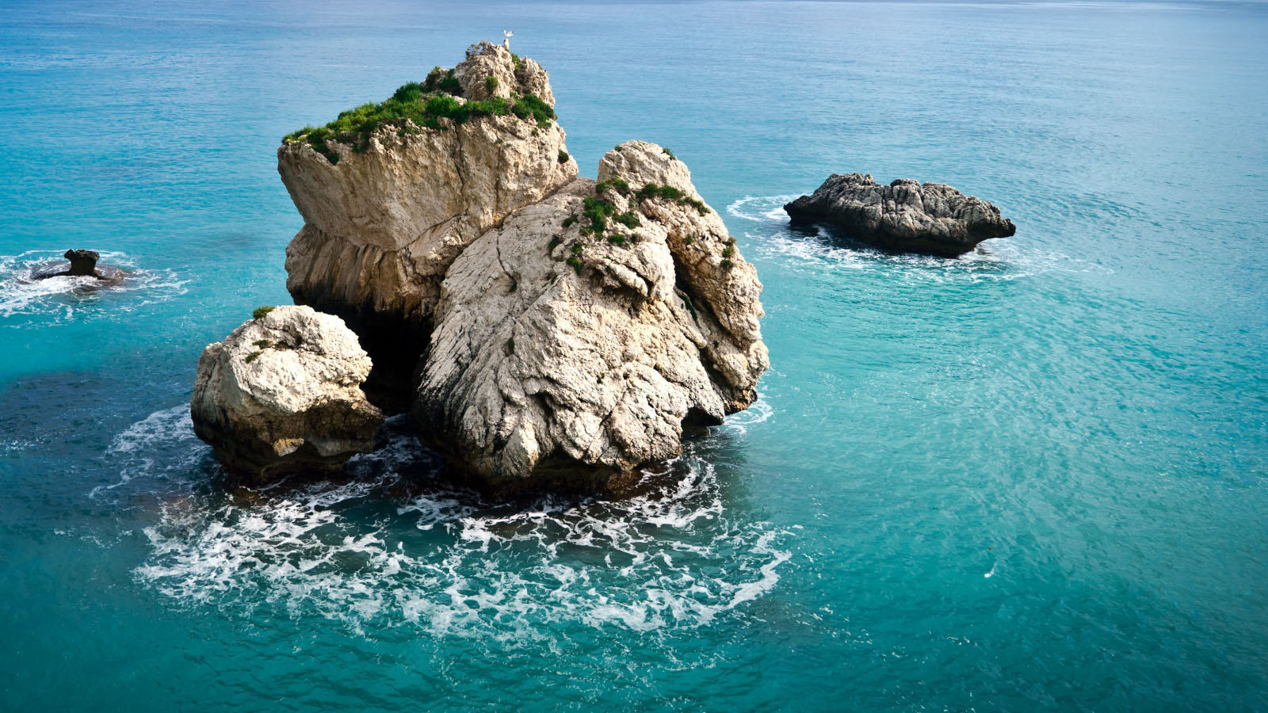
The Geoportal for the Adriatic-Ionian Region (GAIR)
Ivan Sekovski, PAP/RAC
Meeting of PAP/RAC Focal Points, 24-25 May 2021

Slide 2
Main aim
To provide access to datasets, information and tools related to coastal and marine areas for ICZM and MSP in the Adriatic-Ionian region (AIR)
Other existing databases were capitalized, i.e. integrated into a unique Geoportal i.e. GAIR
Opportunity to improve the data sharing and management at transnational level
Supports the EUSAIR Action Plan implementation, cross-cutting to the 4 Pillars of the Strategy (Blue growth, Connecting the region, Environmental quality and Sustainable tourism).

Slide 4
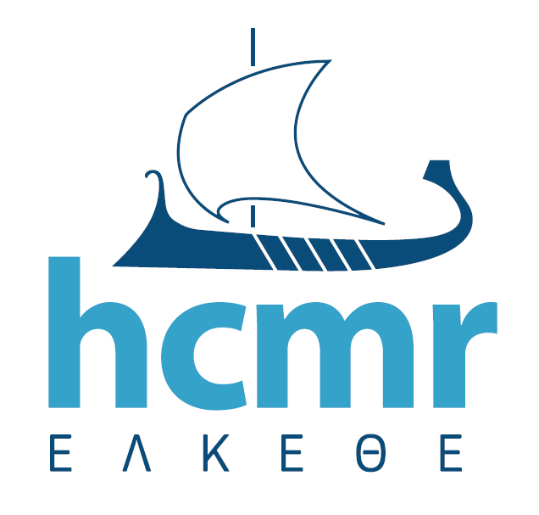
Background
The GAIR is the main output of the project PORTODIMARE,
co-funded by the Interreg ADRION Programme (ERDF + IPA II)
Project budget: 1.581.219,36 EUR (PAP/RAC 162.500,02)
Project duration: February 2018 – January 2021
Partners:
PROJECT PARTNERS
1 - Regione Emilia-Romagna, Direzione Generale Cura del Territorio e dell'Ambiente - IT
2 - CORILA - Consorzio per il Coordinamento delle Ricerche inerenti al Sistema Lagunare di Venezia - IT
3 - Regional development centre Koper - SI
4 - Priority Actions Programme / Regional Activity Centre Split - HR
5 - Hellenic Centre for Marine Research - GR
6 - Institute for Physical Planning Region of Istria- HR
7 - Public enterprise for coastal zone management of Montenegro - ME
8 – Centre for economic, technological and environmental development Sarajevo - BA
9 - Regione Puglia – Protezione Civile
10 - Regione Abruzzo
11 - Regione Veneto
ASSOCIATED PARTNERS
Regione Marche
ARPAE Emilia-Romagna

Slide 5
PAP/RAC’s role
WP2 Geoportal testing and demonstration
Two training workshops
Six case studies in the AIR, by using GAIR’s modules
Strategies and action plans for 4 testing areas
GAIR practical guide
Maintainance and transferability plan

Slide 6
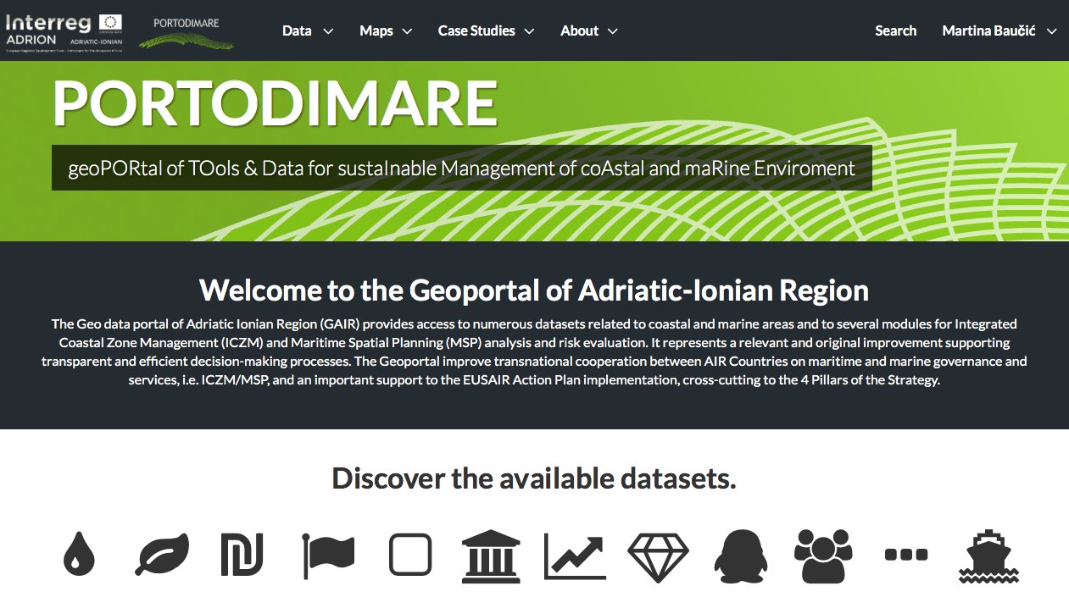
Introductions to GAIR’s main functionallities

Slide 7
Explore datasets

Slide 8
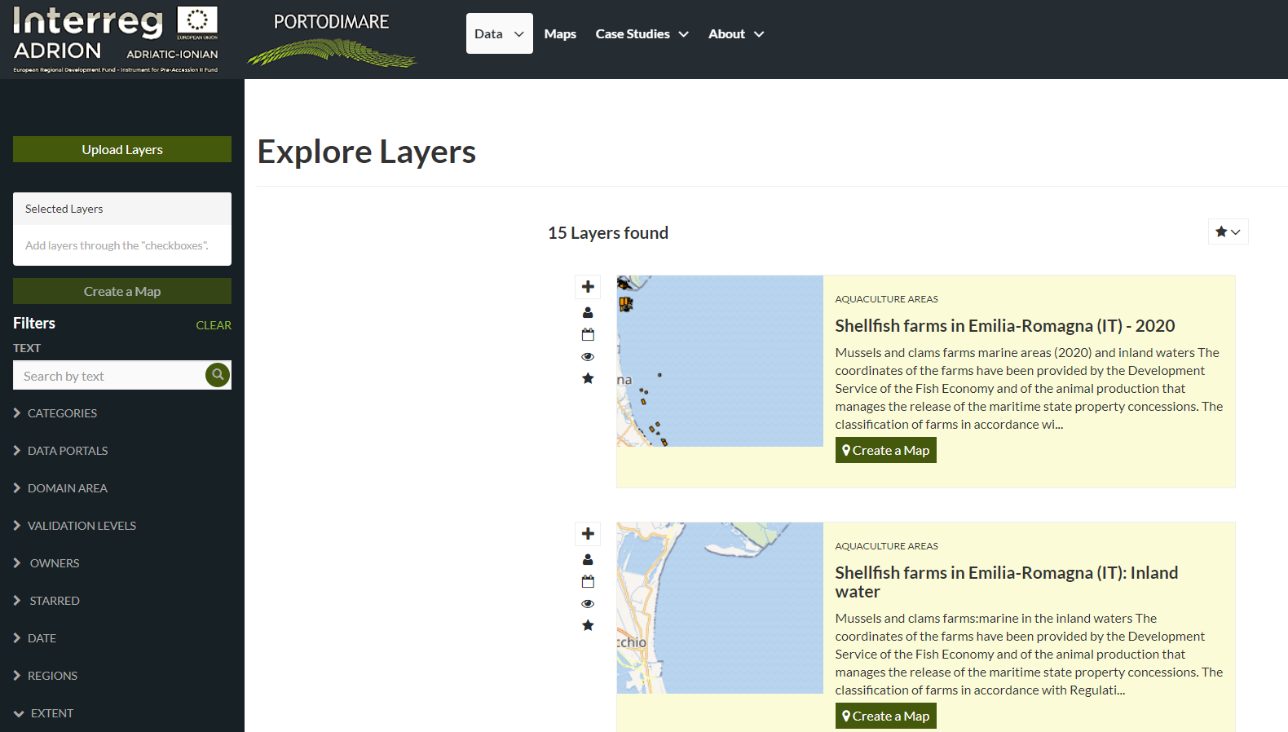
Search (filter)

Slide 9
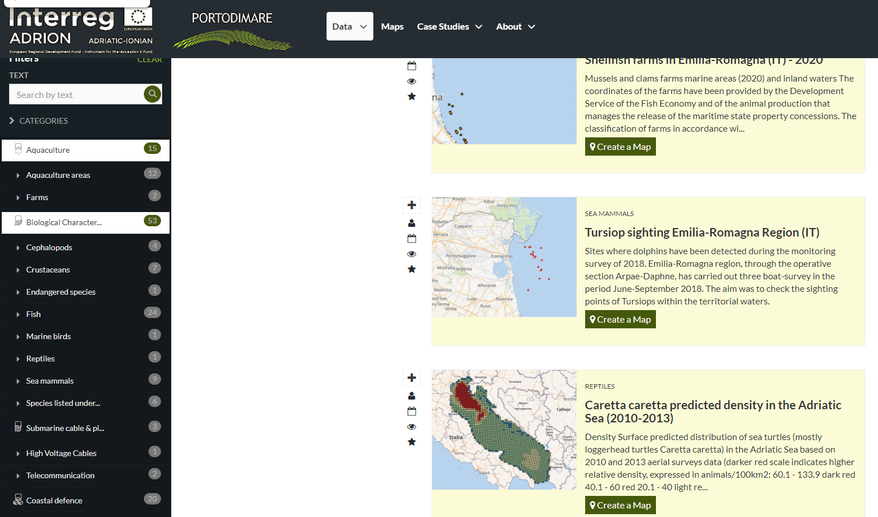
Search (filter)

Slide 10
Modules
Cumulative Effects Assessment
(CEA)
Oil spill coastal vulnerability
Particles tracking simulation
(PARTRAC)
PORTODIMARE Geoportal for data management & visualization
Maritime Use Synergy and Conflict Analysis
(MUC)
Small Scale Fisheries (SSF) footprint
Allocated Zones for Aquaculture
(AZA)
Medium Scale Fisheries (MSF) footprint

Slide 11
Case studies
study “Threats to coastal & marine biodiversity. Step-by-step towards ecosystem-based approach in Vrsar and Funtana islands” (HR) ––CEA + MUC
evaluating sea uses sustainability in Emilia-Romagna (IT) - CEA + MUC + AZA + PARTRAC
spatial conflicts among human activities as well as with conservation priority areas in Western Greek waters (GR) CEA + AZA + MSF/SSF
Abruzzo Region coastal evolution mapping (IT)
Spatial conflicts among existent uses & legal regimes on sea -coastal strip along Slovenian and Bosnian coast (SI & BA) – CEA + MUC
Oil spill coastal grounding response - Puglia (IT)
Strategies & action plans on 4 testing areas of the Geoportal

Slide 12
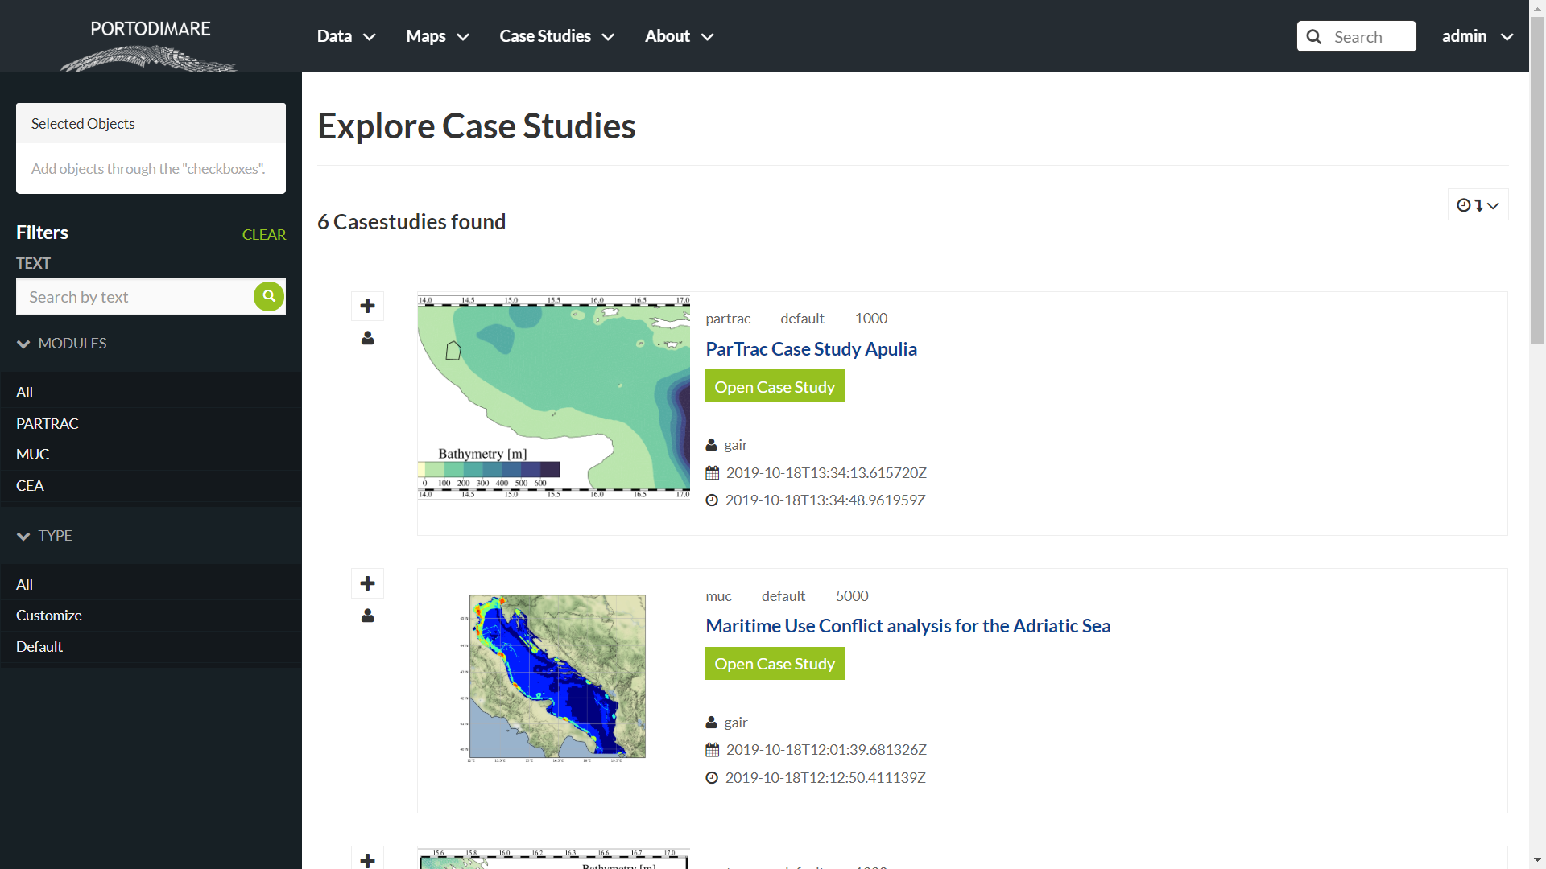

Slide 13
Maps

Slide 14
Summary
Geoportal of Adriatic-Ionian Region (GAIR) was developed
Six case studies in the AIR
Strategies and action plans produced for 4 testing areas
GAIR practical guide developed
Maintainance and transferability plan developed – considers also transferability to other Mediterranean
sub-regions

Slide 15
https://portodimare.eu
Thank you!
ivan.sekovski@paprac.org

