Slide 1
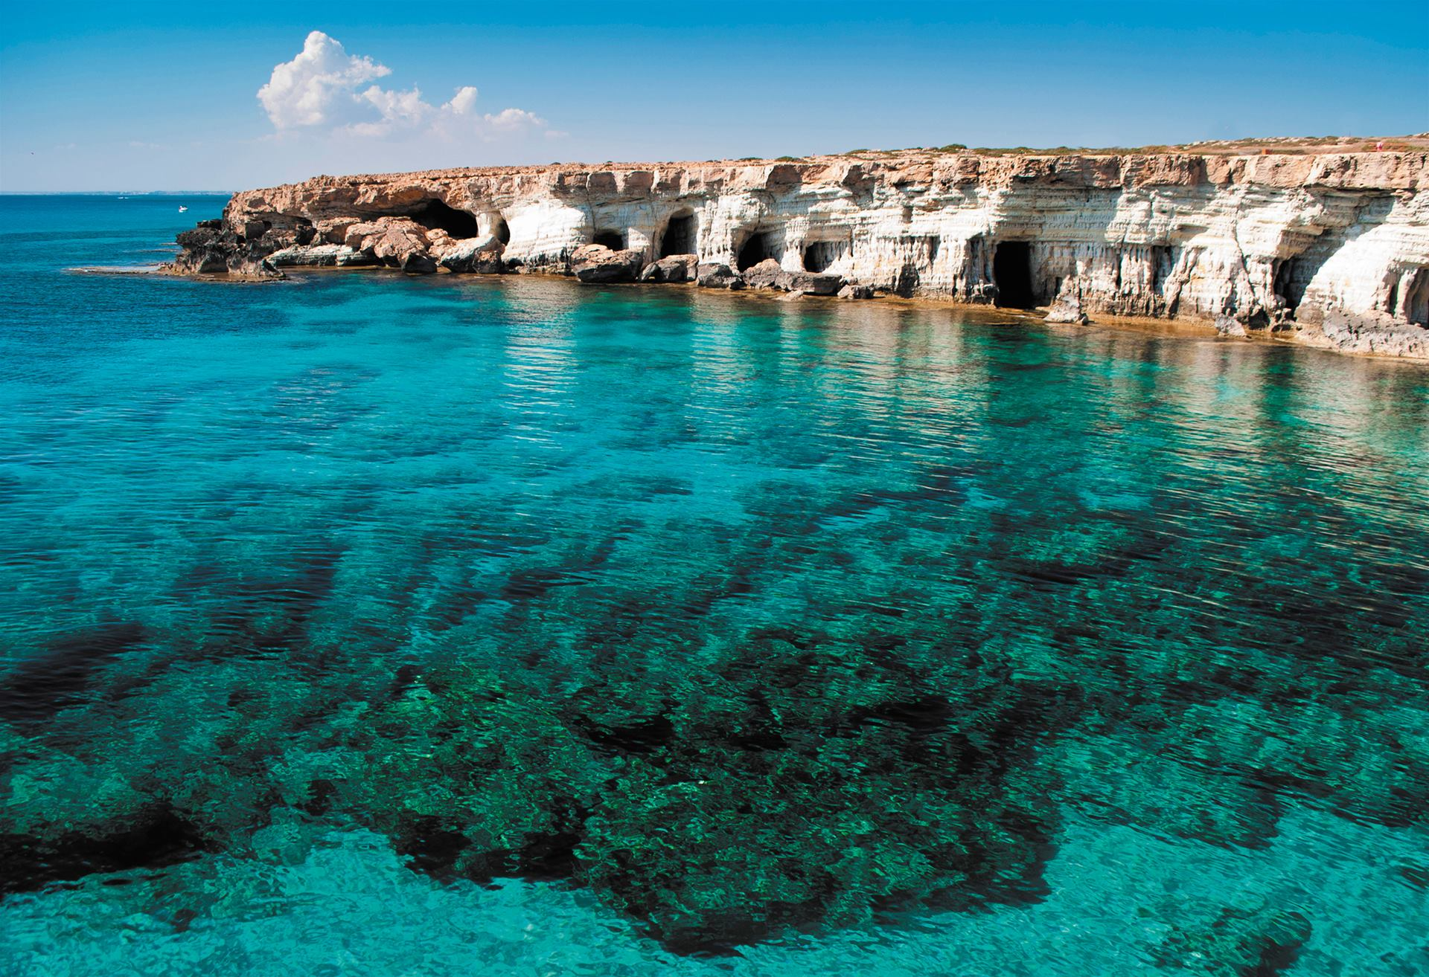


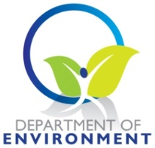


Towards a transboundary Otranto Channel CAMP project for Italy and Albania
First findings and proposals
Daniela Addis, Rezart Kapedani - Ayia Napa, 25 September 2019
Photo credit to be given
as shown alongside
(in black or in white)

Slide 2
Summary
Introducing the CAMP area
Main issues
Proposed activities

Slide 3
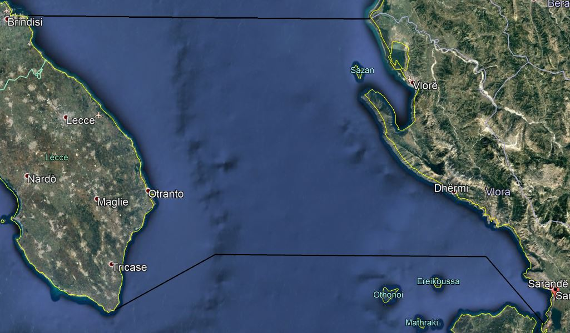
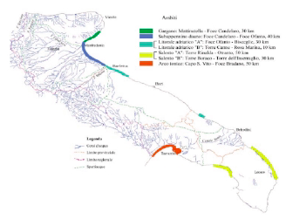
Otranto CAMP area
The coastal unit of the competent
Vlora County in Albania
Puglia Region coastal units of the competent Administrative Provinces of Brindisi and Lecce in Italy

Slide 4
Otranto CAMP area’s aspects
Transboundary context with other selected areas to test procedures and structures for an effective coordination of areas shared by different countries;
Territorial planning instruments and/or experience on management of coastal areas to ensure the feasibility of the CAMP project with existing resources;
Areas with significant naturalistic and environmental value to preserve their biodiversity (i.e. presence of protected natural areas);
Areas interested by economic activities characteristic of the coastal areas (such as tourism);
Areas where are identified interactions between EcAp EOs and elements of the ICZM Protocol focusing, mainly but not exclusively, on the EO1 and 2 (Biodiversity and NIS), EO9 and 10 (Contaminants and Marine and Coastal Litter), with particular attention on pollution and therefore marine litter;
Regional structures and/or processes for coastal management to increase the certainty of success of the project.

Slide 5
Main issues
The FS gives an overview of the main characteristics of the proposed CAMP area:
Geographical description
Hydrography and Geomorphology
History and Cultural legacy
Economic activity
Main Environmental issues
Institutional and legal set-up

Slide 6
Geographical description of the area
Italy - area of Puglia
Albania area of Vlora Qark
Puglia is the Italian easternmost territory, which coasts - surrounded by the Southern Adriatic and the North-Western Ionian - are usually rocky and cliff-like; uneven from Trani to Otranto (low rocky and/or sandy coast) and high and rocky from Otranto to S. Maria di Leuca.
Seabed flat and without morphological features. Bathymetry: 790-126 m depth of the Italian slope in the Adriatic Basin, 16-127 m of the Italian continental shelf.
Length of coastline: 1,041 kilometres.
Coast divided in 7 physiographic units according to the local topography.
Albania is a Balkan peninsula country, 'gateway' of Southeast Europe to the West.
The coast of the Gulf of Vlora consists mostly of cliffs. Erosion of cliffs is prevalent along the coastline with formation of pocket beaches or narrow gravel beaches at the base of slopes.
Gulf of Butrinti and Gulf of Graves have a different landscape.
Seabed has a narrow continental shelf, on average 2.5 km wide, with the -5 m contour located at less than 30 m offshore and the -20 m at 200 m offshore.

Slide 7
Hydrography and geomorphology
Italy - area of Puglia
Albania area of Vlora Qark
Hydrography is characterised by water inflow from the Eastern Mediterranean (entering from the Otranto channel along the Eastern Adriatic coast) and fresh water runoff from Italian rivers.
The region is particularly poor in surface waterways. Rivers are characterized for the most part by short courses with a torrential character: Candelaro, Cervaro and Carapelle.
Natural coastal lakes separated from the Adriatic Sea by narrow sandy cords. Near Otranto there are the Alimini lakes.
Geomorphology: the coastal development is low and uniform along the Adriatic, except for the Gargano promontory, while along the Ionian it varies according to the different areas, passing from the high and rocky coast of Capo of Otranto and of Capo Santa Maria di Leuca to the depression of the Gulf of Taranto. The province with the greatest coastal development is Lecce.
Hydrography The coastal area is covered by swirling rivers, streams of which the most important are: Dukati, Kudhës and Borsh in the northern part of the study area, and Bistrica, Kalasa and Pavllo in the southern part. The Butrint Lagoon is the most important and unique hydrographic unit.
Geomorphology, lithological composition and structural construction of carbonate formations, which build the coastline, create spectacular landscapes, combined with the Ionian Sea, with important sea bays.

Slide 8
History and cultural legacy
Italy - area of Puglia
Albania area of Vlora Qark
Along the coast there are architectural landmarks of historical and artistic importance, such as the Watching Towers that, starting from the Middle Ages, were built for defensive purposes against the Turks.
The area is rich in archaeological finds of great importance, i.e. fossil skeleton of the "Man from Altamura", who lived 150 thousand years ago.
The territory is also interesting, from an architectural point of view of the rural environment, with its charming buildings different for purpose and architectural style: ”poste”, buildings linked to agricultural activities; ”jazzi", structures used for sheep rearing. In the inland, 'masserie', farms dating back to the mid-16th century.
Albanian is spoken by some small communities, the Arbëreshe, which today can be quantified in around 12,500 units
The Vlora region is a gathering of traditions interesting cultural, which are expressions of a prominent ethno-cultural area, called "Labëri". These traditions can be found on areas: such as architecture, folklore, music, handicraft, gastronomy etc.
The county preserves the tradition of Iso-Polyphony, classified by UNESCO in 2005 as a masterpiece of oral non-materialistic heritage for the humanity.
The county is also known for handicrafts, including traditional costumes of various communes, carpets and handmade tapestries, woollen knitwear, knitwear, embroidery, work tools and musical instruments.

Slide 9
Economic activity
Italy - area of Puglia
Albania area of Vlora Qark
Along the Apulian coastline, many social activities that derive from the use of the coastal territory: tourism, recreation, settlement, fishing and aquaculture, industrial, ports, etc.
The main e. activity is tourism with a steady growth trend.
The crops that have the greatest impact on the economy (in particular in the Otranto area) are the olive trees, the rooted, wheat and vegetables. The olive trees provide oil exported all around the world.
The local artisan production present in the area is rich. Products are manufactured using various materials, mainly natural (e.g. the reed baskets, the coloured terracotta bells luck).
Most of the ports are shipping and tourist and play a key role for national and international movement of boats.
The fish economy, with a gradual increase of the mariculture-aquaculture, represents a significant component of the economic and productive structure of the Region, but suffers from the structural and market difficulties of the sector.
Vlora is an important contributor to the Albanian economy.
The structure of the Gross Added Value as per economic sector branches is the following:
Agriculture, Forestry and Fishery 25.5 %
Commerce, Transportation, Hotels 19.4 %
Extractive &Processing Industry 16.5 %
Public administration 10.8 %
Construction 10.3 %
Real estate 8.4 %
Others 9.1 %
One of the most important incomes for the area is the tourism sector.

Slide 10
Main environmental issues
Strait of Otranto
Several EU Sites of Community Interest" (SCI) for their environmental importance.
Due to very dense maritime traffic, this area is very sensitive to pollution caused by ships. It is established an Adriatic Traffic Report System (ATRS), a system for traffic control in the Adriatic Sea and Otranto Strait, in which management is ensured jointly by IT and AL authorities.
A gas pipeline is planned to be built, crossing the Strait of Otranto, with serious repercussions for the environment, tourism and fishery.
Italy
The area has a high naturalistic value and related different environmental constraints.
Natural disasters more frequent, such as the so-called "mucilage".
A long list of Protected Areas: 3 NP, 10 RP, 3 MPA, 16 National Nature Reserves, 7 RNR, 95 SCI of Natura 2000 Network, 3 Other PA, IBA.
The bathing water quality is different dependent on the area of measurement: beaches near the cities have lower quality, along the coast very good.
For the supply of drinking water lowest values.
The collection of urban waste: 34.3% of differentiated.
9.3% of national electricity production from renewable source.
A significant concentration of quarries (8.2%).
Albania
Albania has made significant progress in expanding the protected area network, in 2018 surpassed 18% of the territory. In the Vlora county the coastal area is the most important in Albania for the Posidonia oceanica meadows.
The Vlora county still struggles to have an integrated system of management of waste.
The bathing water quality is different dependent on the area of measurement: beaches near the cities have lower quality, along the coast very good. The issues of drinking water supply and waste water treatment has not been completely solved.

Slide 11
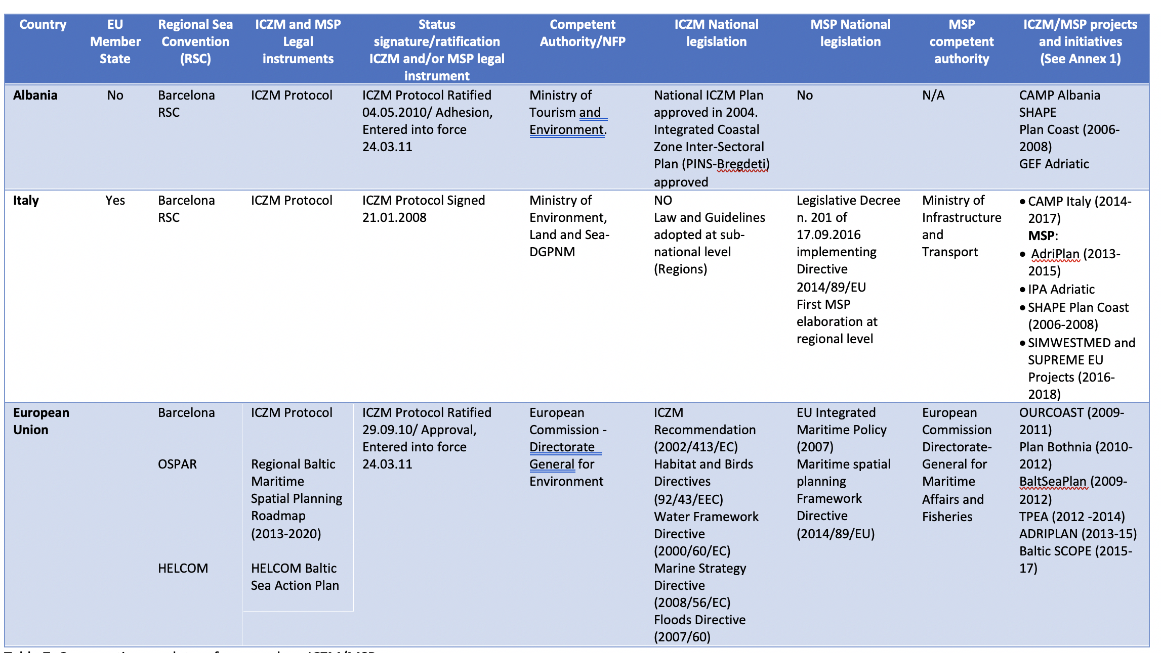
Comparative regulatory framework on ICZM/MSP

Slide 12
Institutional and legal set-up
Italy - area of Puglia
Albania area of Vlora Qark
Puglia is one of the Italian 20 Regions, regulated by an ordinary statute, with 4,048,242 inhabitants divided into 6 Provinces.
Municipality is the first level of local governance, while the Province is the second level and the Region the third level.
Seaside Ordinance of 7.03.2019 prohibiting the use of single-use plastic items on the beaches, which sees involved more than 200 beach operators.
The Vlora County is one of the 12 counties of Albania, divided into 7 municipalities, further subdivided into 200 towns and villages, with a total area of 2,706 km². It has a population of 189,311 inhabitants.
List of main central institutions involved in the institutional set-up of the maritime space.
Name of Institution | Responsibility
Ministry of Defence | Management of national borders, territorial waters and national security issues
Interinstitutional Marine Operational Center | Surveillance of Albanian maritime space, to achieve the organization, planning, coordinating, and directing operations at sea
National Agency of Water Management | Integrated management of water resources, policy making
Ministry of Infrastructure and Energy | Maritime transportation, hydrocarbon exploitation and search, port management
Ministry of Agriculture and Rural Development | Exploitation of fish resources, aquaculture activities
Ministry of Interior | Control of anti-smuggling, anti-traffic activities
Ministry of Tourism and Environment | Monitoring and protection of water quality and marine biodiversity
Ministry of Health | Monitoring of bathing waters
Ministry of Education, Sports and Youth | Scientific Research in the maritime area, education curricula etc.
Ministry of Culture | Management of underwater archaeological resources

Slide 13
Spatial planification
Italy - area of Puglia
Albania area of Vlora Qark
Code of Cultural Heritage and Landscape providing for the adoption by the Regions of Regional Landscape Plans.
Regional Document of General Structure (DRAG) defining the general lines of regional planning to which all lower level planning tools must coordinate.
Territorial Landscape Plan (2015).
Thematic Territorial Landscape Plan of landscape and environmental assets - Thematic Urban Landscape Plan "Landscape" (2000).
Regional Coastal Plan (2011), governing the use of the Demanio Marittimo areas, with the aim of guaranteeing the correct balance between safeguarding the environmental and landscape aspects of the Apulian coast, and the free use and development of recreational tourism activities.
Provincial Territorial Coordination Plans (2001) an act of general planning that defines the strategic guidelines for regional planning at the supra-municipal level.
General Regulatory Plans of coastal municipalities.
Planning of the Parks: adoption of the Plan of the Alta Murgia National Park in 2016.
General National Plan (PPK) "Albania 2030”, the highest instrument of territorial planning, which addresses planning issues in an integrated way, viewing the territory as a whole.
Integrated Coastal Zone Inter-Sectoral Plan (PINS-Bregdeti) providing the vision of coastline development.
General Local Plans (PPV) at a municipality level.

Slide 14
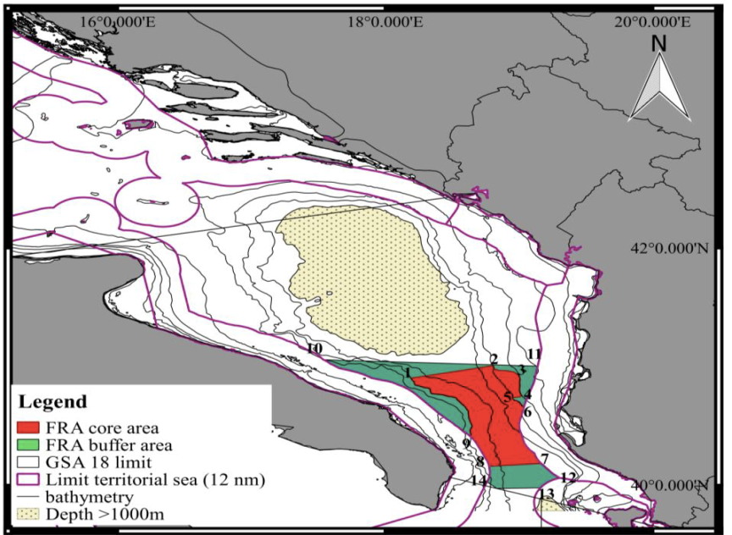
MSP, ABMTs
MSP
ABMTs
Italian Legislative Decree No. 201 of 17.08.2016, implementing the MSP Directive 2014/89/EU and Decree of the President of the Council of Ministers of 1.12.2017 containing the guidelines and criteria for the preparation of maritime spatial management plans.
They foresee, for the trans-boundary cooperation, the usefulness of envisaging from the very beginning the participation of Member and Non-Member but neighbouring States in national planning, through instruments such as programme agreements or technical and/or consultation panels and forums, or similar, also taking advantage of utilising European projects in which Italy participates.
Operative tools for the sustainable use of the sea within a planning approach: proposal of two Fishery Restricted Areas (FRAs)
1. ’Bari Canyon’;
2. ‘Otranto FRA for the protection of deep water essential fish habitats in the South Adriatic’.

Slide 15
Proposed activities
Proposed activities from the point of view of the national and local transboundary character needing planning coordination, are structured at 3 levels:
Strategic level, which defines the main themes for which to be developed specific project activities and deliverables;
Sectoral level, which defines specific activities and deliverables to be developed for each theme;
Operational/activity level, which deals with the operational implementation of the activities at joint/transboundary or a local/site specific level.

Slide 16
Identified goals for the CAMP Otranto
A strategic objective: testing the transboundary integrated management of coastal areas (both implementing the ICZM Protocol and the MSP), with actions aiming at
  reduction of pollution (marine litter);
  improving sustainable tourism;
  enhancing conservation of natural habitats and biodiversity, in particular through marine and costal protected areas and OECM.

Slide 17
Identified goals for the CAMP Otranto
2) Specific joint/transboundary complementary objectives with activities specifically targeted on the identified themes:
  developing specific recommendation on the best application and implementation of the Methodological Guidance of the CRF for ICZM, on the basis of its testing in the project area;
  exchanging experiences and collaboration between Albania and Italy in the implementation of the ICZM and in the maritime spatial planning.

Slide 18
Identified goals for the CAMP Otranto
3) Operational implementation of the activities at a local/site specific level to improve the knowledge on BC, ICZM and MSP, and the related EU instruments, at the local level:
  establishing and implementing an ICZM management system and audit scheme (ICZM SAS) to guarantee the coherence, homogenization and interlinkages among the different project activities;
  developing a Concept Note on MSP for the Albanian side, on the basis of the Italian experiences into the implementation of MSP Directive and considering the Conceptual Framework of MSP developing within the CRF for ICZM.

Slide 19

Thank you!
Eυχαριστίες!
Avv. Daniela Addis
Law Firm
Environment&Sea
Rome IT
tel. +39 351 622 9550
E-mail: daniela.addis@me.com -
Photo: Patrizia Mascia

